Slide 1
Supporting your child through SQA examinations
Lenzie ACADEMY

Slide 2
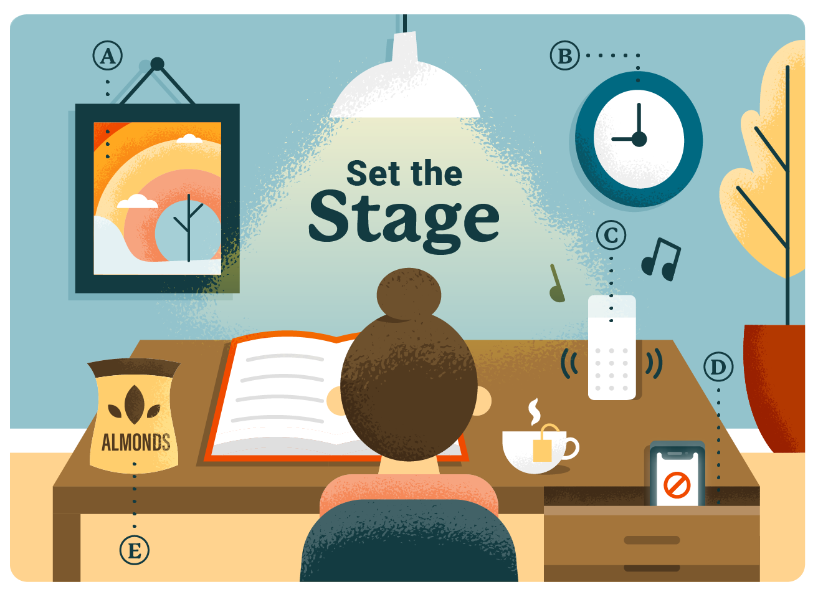
Stick with an environment that works
Inform family and friends
Schedule set study times
Remove distractions
Be organised
Listen to calming music

Slide 3
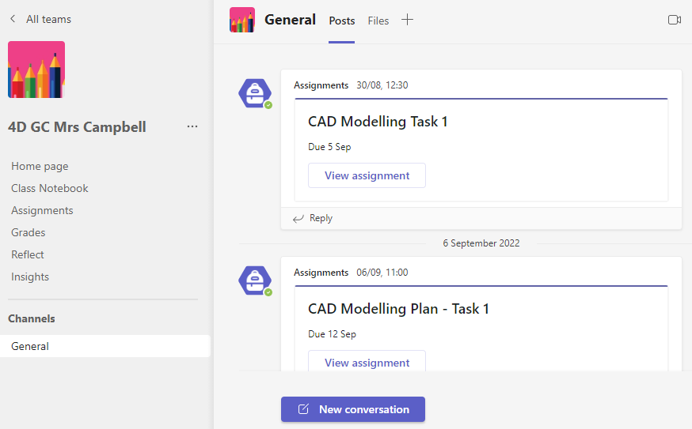
Microsoft Teams
Used regularly to provide students with course notes/homework/revision
Information from teacher
Assignment (homework)
Communication between teacher and student

Slide 4
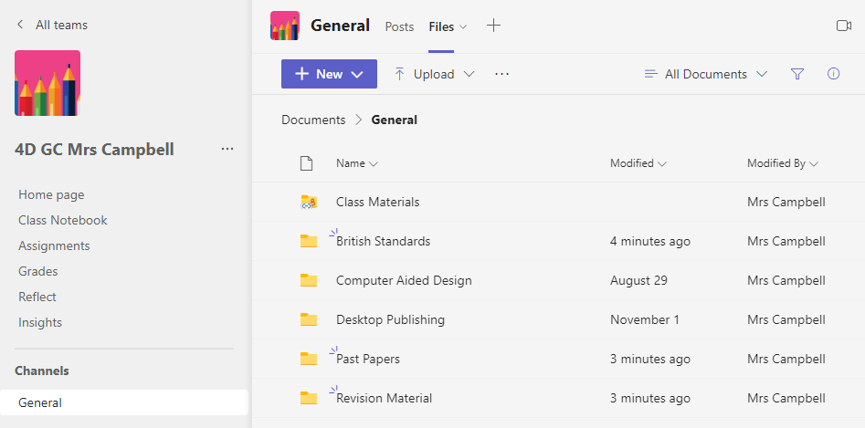
Microsoft Teams
Course notes/Past papers/Revision questions

Slide 5
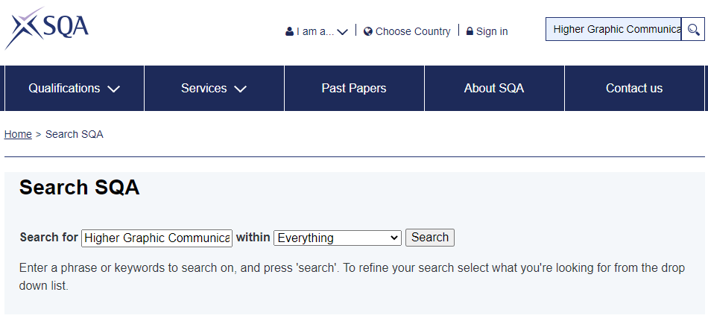
SQA Website
Type in Level & Subject
All course information will be found here

Slide 6
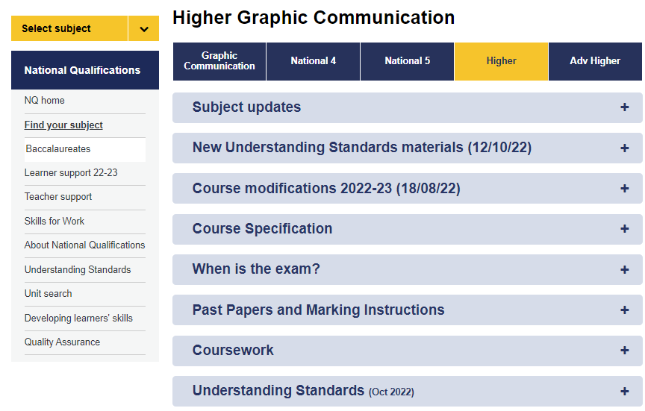
Examinable areas
Previous exams with ANSWERS!

Slide 7
Course Specification – Revision list
Talking point
Green – confident
Red – Less confident

Slide 8
Past Papers & Marking Instructions

Slide 9
Marking Instructions
How students should answer certain questions

Slide 10
Marking Instructions
Common mistakes students may make when answering the question
Wording can be different but must have the same meaning

Slide 11
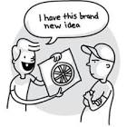
School context
The Learning and Teaching committee is working with Osiris Educational
Focus on visible learning, mindsets, metacognition, building resilience.
OUR AIM: is to have metacognition and effective feedback strategies embedded into our school curriculum.

Slide 12
‘Thinking about one’s thinking’

Slide 13
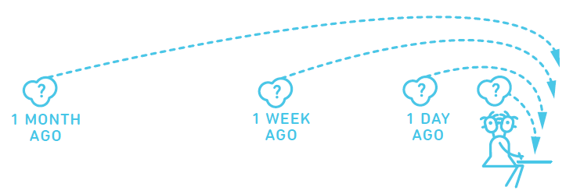
Spaced Practice
A little bit of time every day
Review information from each class, but not immediately
Use active retrieval practice strategies, not just reading notes

Slide 14
Interleaving
Switching between ideas during a study session.
Not studying one idea for too long
Go back over the ideas again in different orders to strengthen understanding

Slide 15
Retrieval Practice
Actively retrieving information from memory without the support of class notes or revision booklets

Slide 16
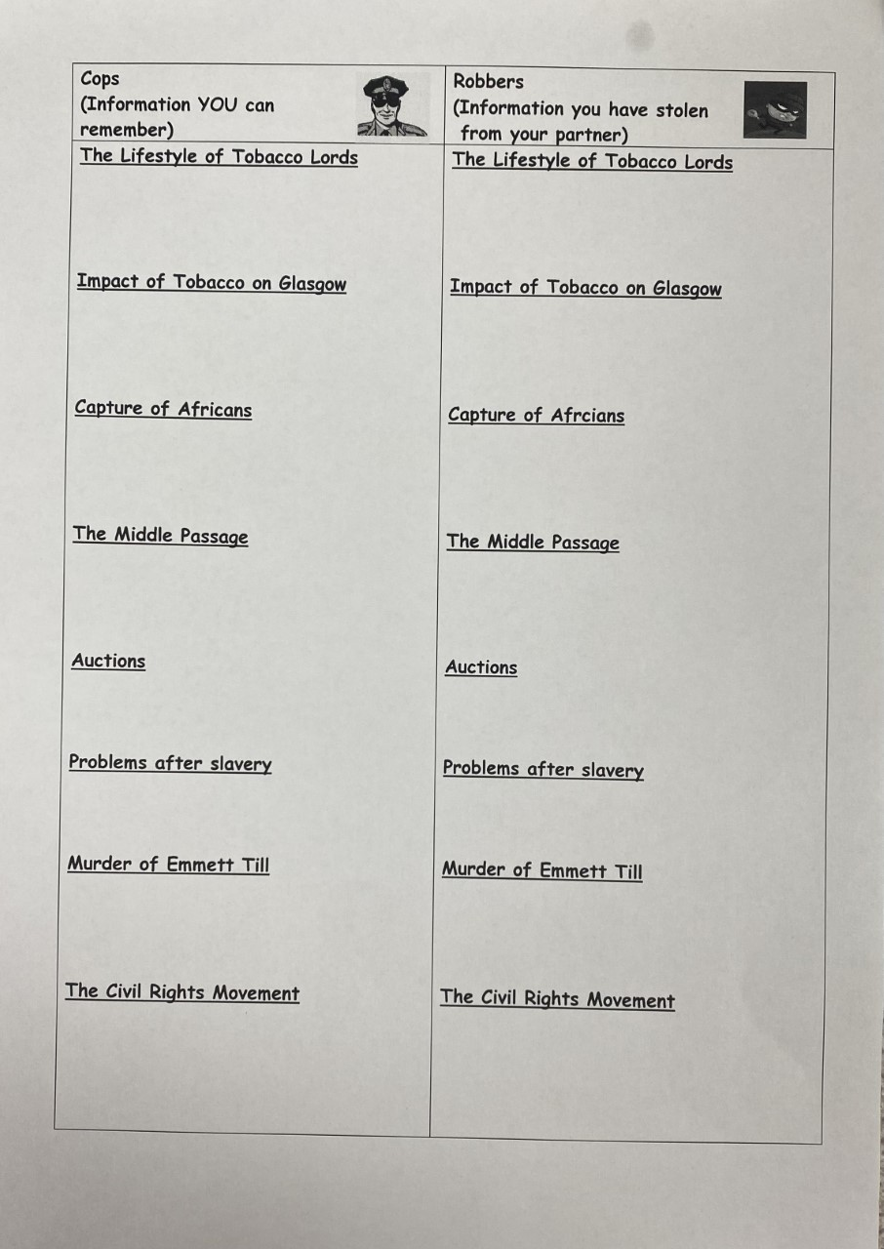
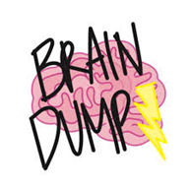
Brain dump
Picture prompt
Cops and robbers

Slide 17
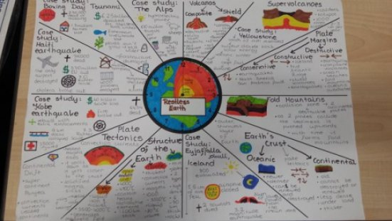
Spot the error
Challenge grid
Revision clocks

Slide 18
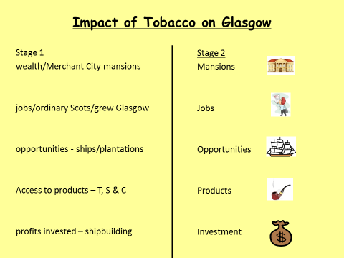
Give me 5
Flashcards

Slide 19
Supporting revision at home through retrieval practice:
Flashcards
Quizzing
Supporting ‘brain dumps’ – checking for accuracy
Practice questions – checking answers

