Slide 1

QS Family Learning 2026/27
National 5 Applications of Maths

Slide 2

Aims of the session
Overview of the course
Assessment calendar
Resources
Questions

Slide 3
Nat 5 Apps Course Outline
S5/6 Course
S4 Course
Statistics
Probability
Foreign Exchange
Earning Money - Pay/Overtime/Commission/Tax/NI/Net Pay
Savings & Borrowing
Spending Money - HP/Shares/Best Deals
Scattergraphs, Stem-and-leaf & Pie Charts
Unit Assessment - Finance and Stats (SEPTEMBER)
Bearing and Scale Drawings
Pythagoras Theorem
Perimeter & Area
OCTOBER ASSESSMENT – w/b 26th October
Gradient
Volume
Tolerance
Time Zones and SDT
Precedence Tables
Container Packing
Unit Assessment - Geometry and Measure
JANUARY ASSESSMENT - calculator
Percentage appreciation/depreciation
Decimals/Fractions/Percentages
Reading/Writing Scales
Ratio
Proportion
Unit Assessment - Numeracy
MARCH ASSESSMENT - non calculator
UNIT ASSESSMENT NUMERACY
Ratio
Proportion
Percentage appreciation/depreciation
Reading/writing scales
Statistics
Scattergraphs, Stem-and-leaf & Pie Charts
SEPTEMBER ASSESSMENT - Wednesday 30th September
Probability
Foreign Exchange
Earning Money - Pay/Overtime/Commission/Tax/NI/Net Pay
Savings & Borrowing
Spending Money – Hire Purchase/Shares/Best Deals
UNIT ASSESSMENT STATISTICS & FINANCE
Gradient
Pythagoras
Container Packing
Precedence Tables
Time Zones and SDT
Tolerance
Area & Volume
JANUARY ASSESSMENT
Perimeter
Bearing and Scale Drawings
UNIT ASSESSMENT GEOMETRY & MEASURE
Decimals/Fractions/Percentages
MARCH ASSESSMENT - non calculator

Slide 4

QS Exam 2027
Monday 26th April 2027
9.00 – 09.50: Paper 1 non-calculator (35 marks)
10.30 – 12.10: Paper 2 calculator (55 marks)
All results for N5 Apps are 100% exam based.

Slide 5

Key Resources
Notes jotter and Teams – regular revision of key topics.
Post assessment forms – strengths & areas for development.
Zeta electronic textbook (password Lnzac).
Free N5 Apps website (specifically sections 2-4).
https://www.national5maths.co.uk/n5-lifeskills-maths/
Achieve Learning website.
https://achieve.hashtag-learning.co.uk
Department drop-in sessions.

Slide 6
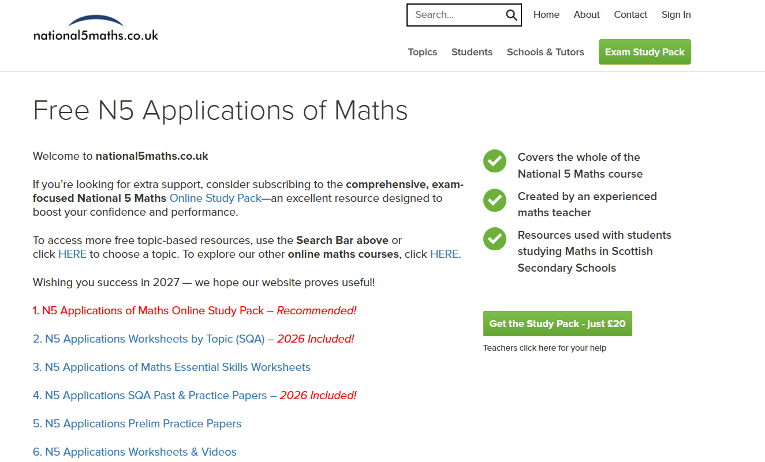

Slide 7
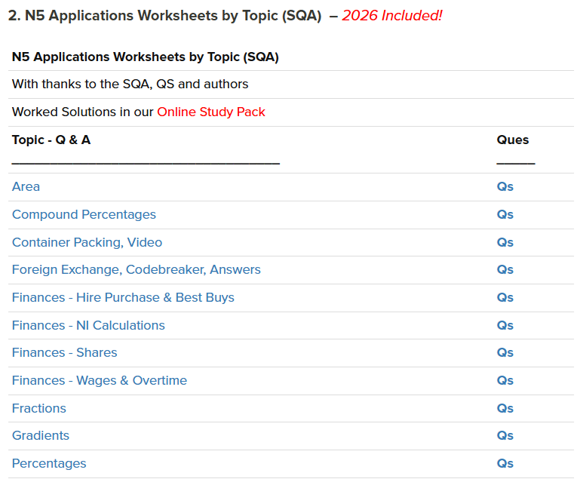
Particularly good for:
targeting areas for development following assessments
revising throughout the year when the course isn’t complete

Slide 8
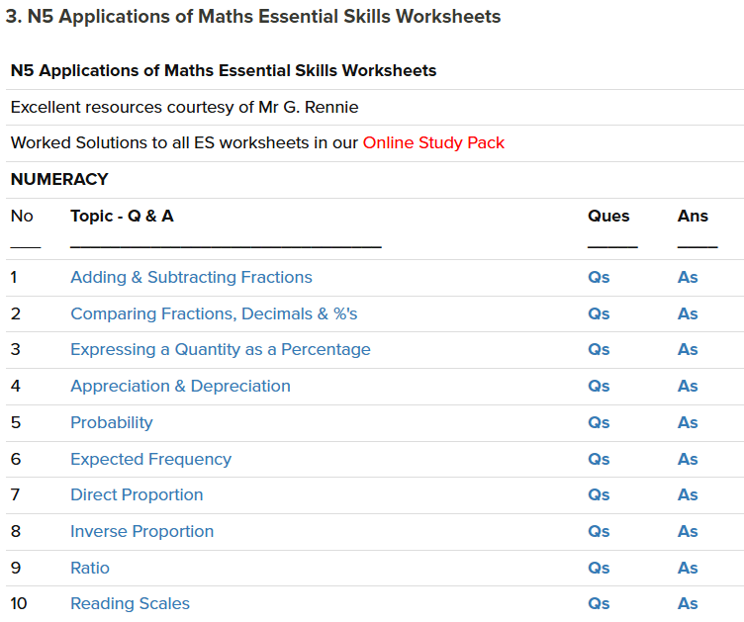
Particularly good for:
repetition of specific skills
building confidence before tackling past papers

Slide 9
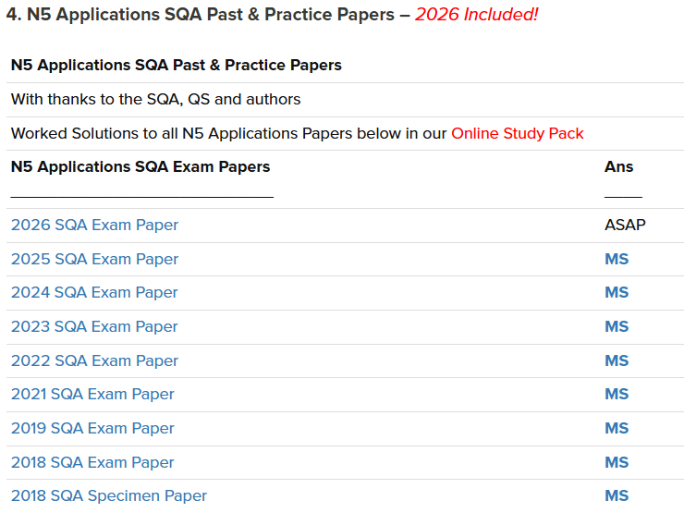
Particularly good for:
end of course assessment preparation
SQA marking schemes & marking notes

Slide 10

Questions?

