Slide 1

Lenzie Academy Physics Department
Preparing your child for QS Exams
National 5 Physics
15th September 2026

Slide 2

N5 Course Structure
3 Units:
1. Waves and Radiation (covered in S3)
2. Dynamics and Space (covered in S3/S4)
3. Electricity and Gas Laws (covered in S4)
80% of the course is based on the final exam and 20% on the assignment task which will be completed in class in December.
An in-class revision programme for N5 will begin at the end of February-April.
Ambition •
Lenzie Academy
•
Inclusion
Physics Department

Slide 3
Exam Structure
Prelim in January – covers the full course and is used for QS estimates and evidence.
Final exam date: Tuesday 4th May 2027
13:00 – 15:00 (2 hours)
Exam Format:
Section 1 – 20 marks of multiple-choice questions.
Section 2 – 90 marks of extended answer questions.
Ambition •
Lenzie Academy
•
Inclusion
Physics Department

Slide 4
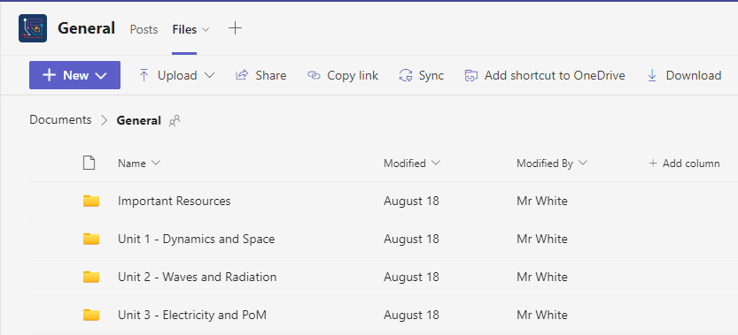
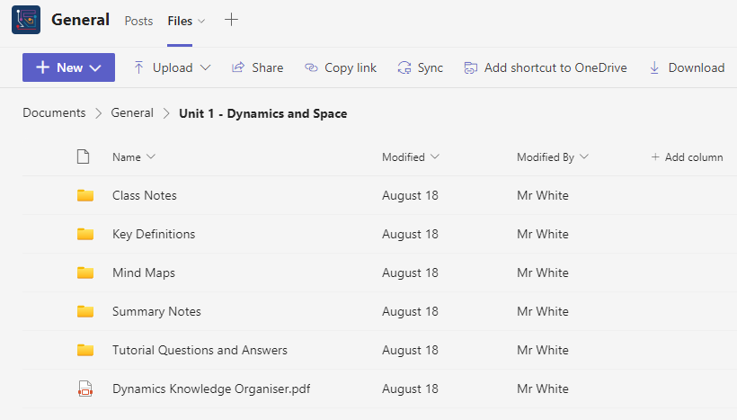
Teams Pages
Ambition •
Lenzie Academy
•
Inclusion
Physics Department

Slide 5
Revision Advice
Select area of course for revision (e.g. Newton’s Laws)
Read and review notes on that area (flashcards, mind maps, summary notes)
Ambition •
Lenzie Academy
•
Inclusion
Physics Department

Slide 6
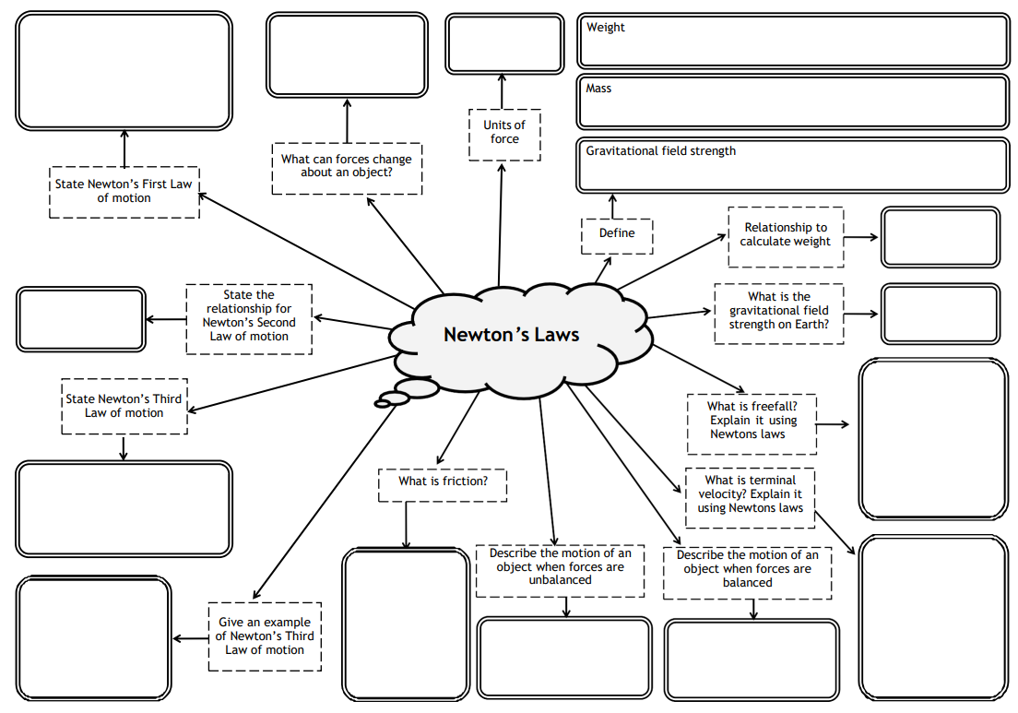
Example: Mind Maps
Ambition •
Lenzie Academy
•
Inclusion
Physics Department

Slide 7
Revision Advice
Select area of course for revision (e.g. Newton’s Laws)
Read and review notes on that area (flashcards, mind maps, summary notes)
Try the associated problems (tutorials and then past papers)
Ambition •
Lenzie Academy
•
Inclusion
Physics Department

Slide 8
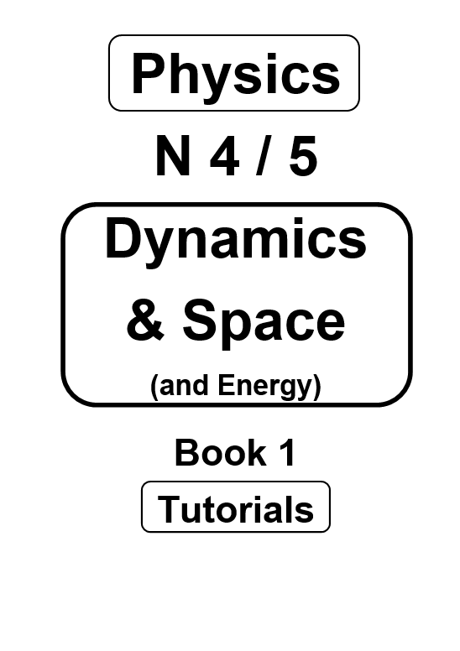
Tutorials
All pupils given physical booklets with answers on the back pages.
Problem practice is key to success in Physics.
Increasing in difficulty with some past paper questions at the end.
Digital copies on the class Teams pages.
Ambition •
Lenzie Academy
•
Inclusion
Physics Department

Slide 9
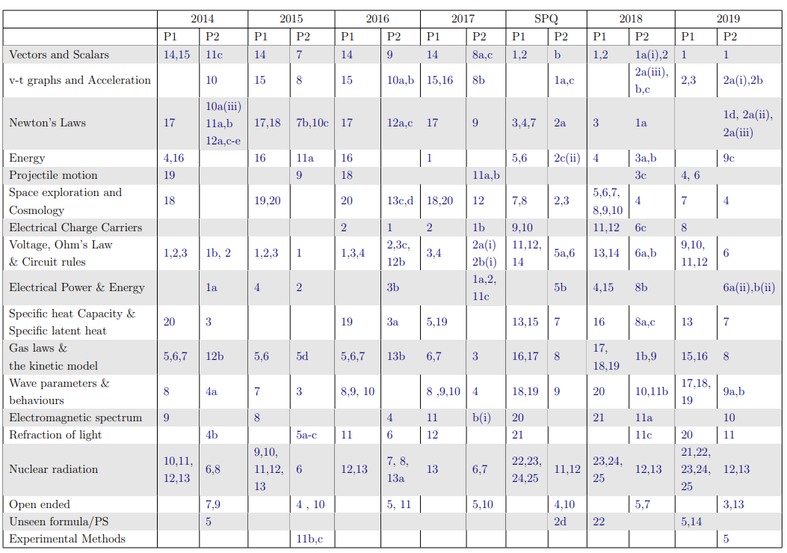
Past Papers
Ambition •
Lenzie Academy
•
Inclusion
Physics Department

Slide 10
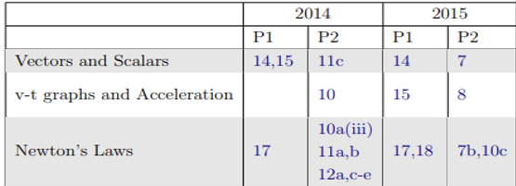
Past Papers
Full past papers and a link to old past papers is provided on class Teams pages.
Ambition •
Lenzie Academy
•
Inclusion
Physics Department

Slide 11
Revision Advice
Select area of course for revision (e.g. Newtons Law’s)
Read and review notes on that area (flashcards, mind maps, summary notes)
Try the associated problems (tutorials and then past papers)
Move on to the next area.
Complete full past papers (timed) and log results.
https://jabchem.org.uk/
Ambition •
Lenzie Academy
•
Inclusion
Physics Department

Slide 12
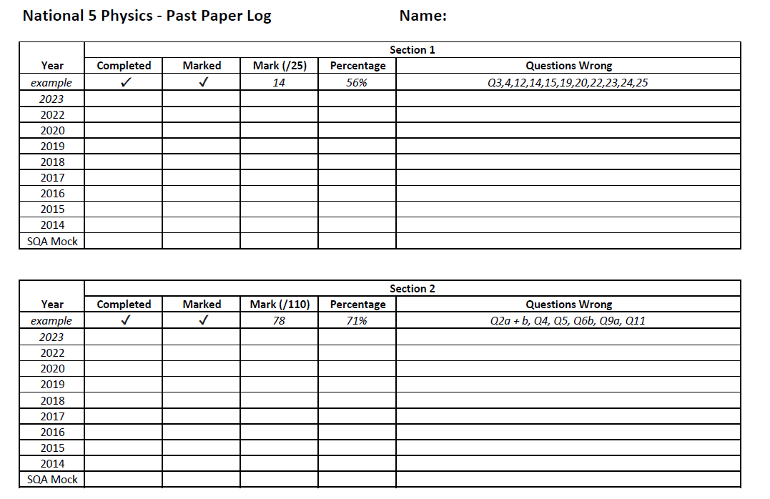
Past Paper Tracker
Ambition •
Lenzie Academy
•
Inclusion
Physics Department

Slide 13

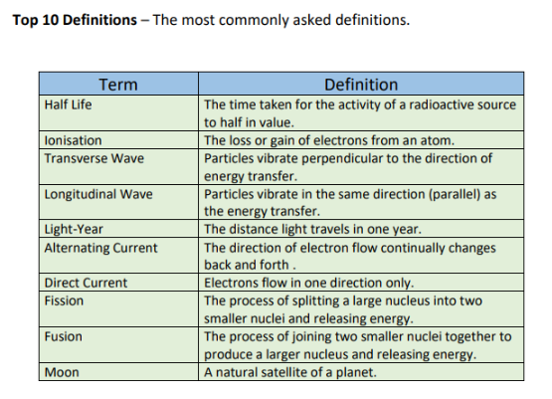
Definitions and Graphs
Ambition •
Lenzie Academy
•
Inclusion
Physics Department

Slide 14
Additional Support
Supported Study
Will take place weekly closer to the exams – sign up sheets outside S13.
Come with questions.
Lunchtime Drop-in (1:10 – 1:50)
Any member of the Physics department will be able to help but please ensure pupils come prepared with questions.
In-Class Revision Programme (February-April)
Approx. 5 weeks in class where pupils will have time to ask for assistance.
Ambition •
Lenzie Academy
•
Inclusion
Physics Department

Slide 15
Things you can do at home
To support your child with Physics you could:
Encourage them to complete the past papers and monitor their progress using the highlighted checklist or past paper log.
Review the advice in the pupil's study guide booklet and encourage your child to follow the guidance.
Help them recall equations and definitions by reading terms on the definition sheets (on Teams) and asking them to respond.
Check mind maps and use them to ask your child questions.
Ambition •
Lenzie Academy
•
Inclusion
Physics Department

Slide 16
Any Questions?
Thank you for attending!

