Slide 1
National 5 media
Family Learning

Slide 2
What’s in the course?
Analysis of Media Content (Exam Paper 1) –
Six questions in total – no essay style questions
Most questions based around one of the key aspects: Categories; Language; Narrative; Representation; Audience; Institutions; Society
One question – Role of Media
One question – Unseen Analysis (any film poster)
(50%)
Assignment (coursework) –
A year long project that involves planning, creating, analysing and evaluating your own media content (50%)

Slide 3
Analysis of Media Content (Exam Paper) (50%)
There are two parts to this paper:
  Paper One Section 1:
  Students will be introduced to the 7 key aspects of media and will be expected to apply their knowledge and understanding of these key aspects to a media text studied in class.
  This will involve writing answers in questions worth 6-10 marks. Each question will name a key aspect and students will describe and explain how this has impacted their chosen media texts – A Quiet Place, Shutter Island and Derry Girls.
  Paper One Section 2:
  Students will be presented with one unseen media text (film posters). Using the 7 key aspects of media, students will analyse the ways in which key aspects of media literacy have been used to achieve a purpose or appeal to audience. This question is worth 10 marks.

Slide 4

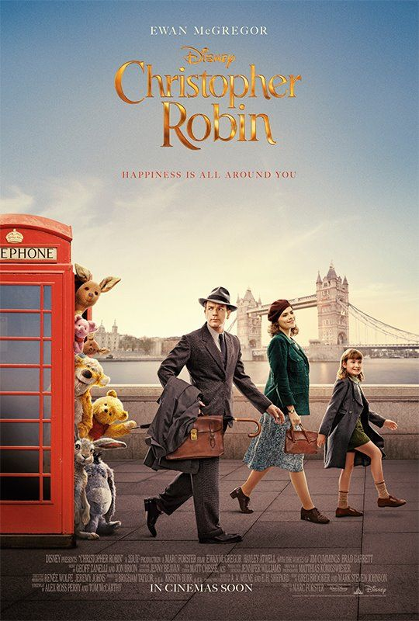

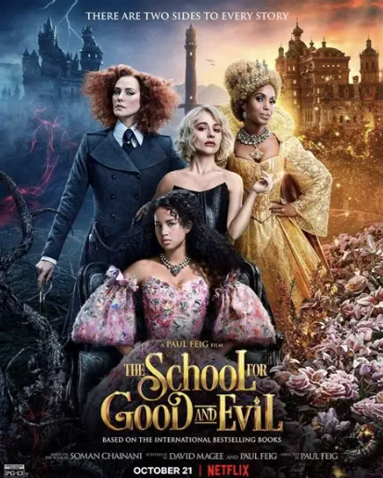

Slide 5
Assignment (50%)
The assignment is a year-long project and involves pupils creating and evaluating their own media content based on a brief negotiated with the class teacher.
Final projects must be a finished media product, with the level of finish at National 5 expected to be a storyboard of a short film or a film trailer.
Students are graded on the production, research, analysis and evaluation of their project. The media content created itself is not graded but is used as a guide by the QS in the marking process.
There is no upper word limit, but most National 5 assignment write ups range from 2000-4000 words long.
Due to the length of the assignment, it is crucial that pupils meet the deadlines provided by their class teacher to avoid falling behind.
If a pupil falls behind, it will become difficult for class teachers to provide crucial feedback on each section.

Slide 6
Assignment (50%)
The assignment is broken into two sections: the Planning Section (20 marks) and the Development Section (30 marks).
Planning Section –
Candidates respond to a production brief set by the class teacher. They must research relevant media content, their target audience, genre, and institutional constraints they’ll face during the filming process. The emphasis is not simply on stating what they plan to do, but on explaining why their choices are appropriate for the brief, audience and intended purpose.
Development Section –
Candidates then put their plans into practice and create the finished media content, in this case a storyboard. Higher Media requires a finished film. They explain and evaluate the work completed in their production role, including any challenges encountered and how these were overcome.
They also evaluate how effectively they implemented media codes in their finished content, such as camera angles/shots, sound design, editing and mise-en-scene.

Slide 7
Can I revise for media?
Absolutely!
There are:
  Poster analysis skills to practise
  Re-watching of the class text and key scene analysis to learn
  Mind-maps to complete on the relationship between each key aspect and the media content they have studied
  Mind-maps to complete on key themes/ ideas in texts studied in class
  The more familiar they are with the skills and texts, the easier recall will be in the exam.
  Keeping up with assignment work is essential as it is worth 50% of the overall course award. Producing a strong assignment can therefore make a significant difference to a candidate’s final grade.

Slide 8
Practical Help
  Encourage your child to re-watch key scenes in the media texts they are studying. Get them to tell you what the key ideas are and to pick out media techniques that reinforce these.
  Help to learn how the creators of media texts use a variety of techniques. Ask them what media techniques are present in a key scene and get them to analyse the effect!
  Get them to tell you about the films they are studying – key themes, main characters, and how the film explores important social issues. You could even watch similar films to develop further (ones in the same genre, or that are influenced by the same societal issues).
  Encourage them to look at film posters (class teachers will provide a booklet with a variety of film posters from different genres) and analyse techniques contained in the posters (genre conventions, mise-en-scene, character representations, narrative techniques).

Slide 9
Any questions?

