Slide 1

GRAPHIC COMMUNICATION
QS Family Learning Event

Slide 2
Welcome to the DT department
Course breakdown for National 5/Higher Graphic Communication
British Standards
Computer Aided Design (CAD)
Desktop Publishing (DTP)

Slide 3
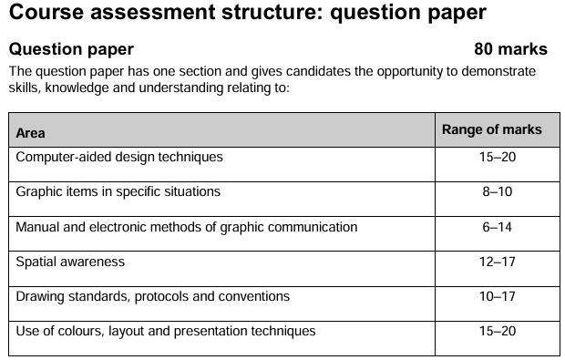
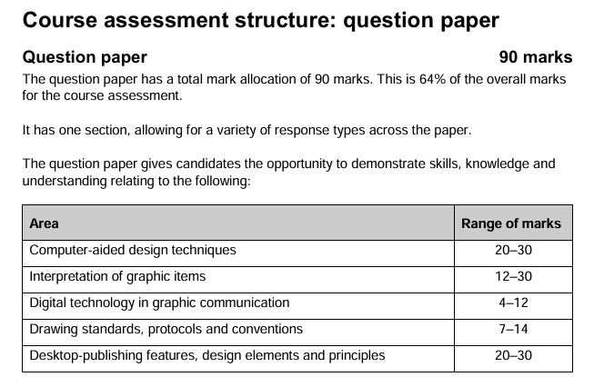
Question Paper (120 marks or 140 marks)
Question Paper – Nat 5 (80 marks), Higher (90 marks)
NAT 5
HIGHER

Slide 4
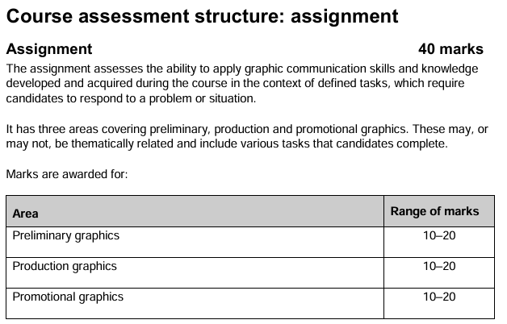
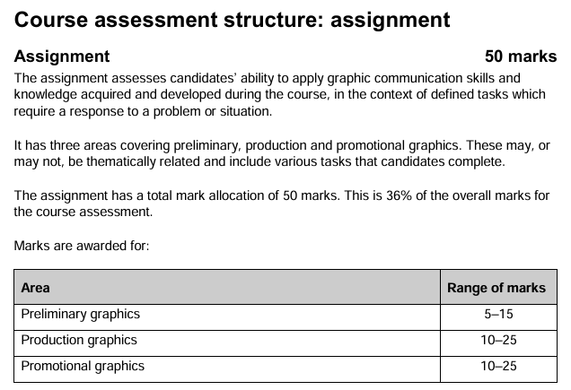
Assignment
Assignment– Nat 5 (40 Marks), Higher (50 marks)
NAT 5
HIGHER

Slide 5
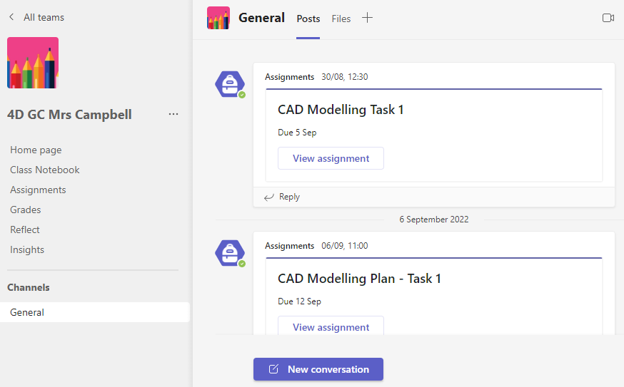
Microsoft Teams
Used regularly to provide students with course notes/homework/revision
Information from teacher
Assignment (homework)
Communication between teacher and student

Slide 6
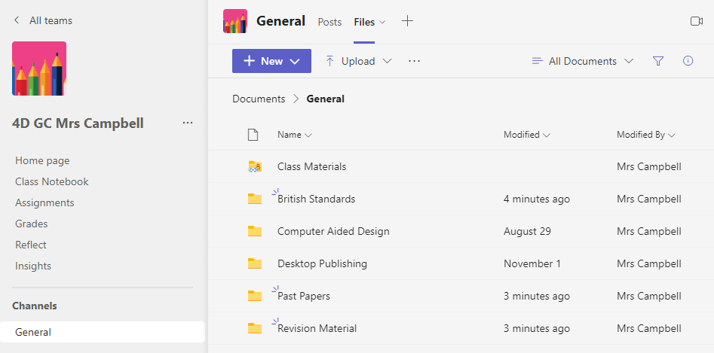
Microsoft Teams
Course notes/Past papers/Revision questions

Slide 7
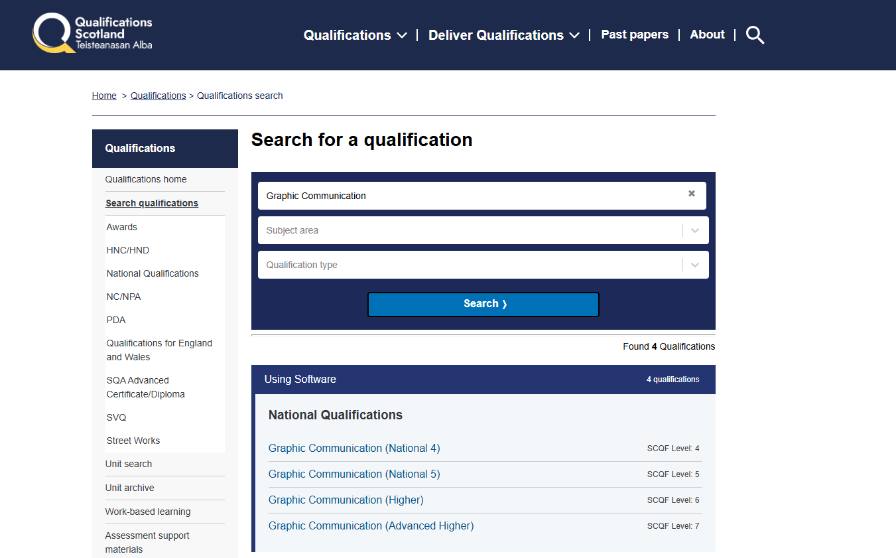
QS Website
Type in Level & Subject
All course information will be found here

Slide 8
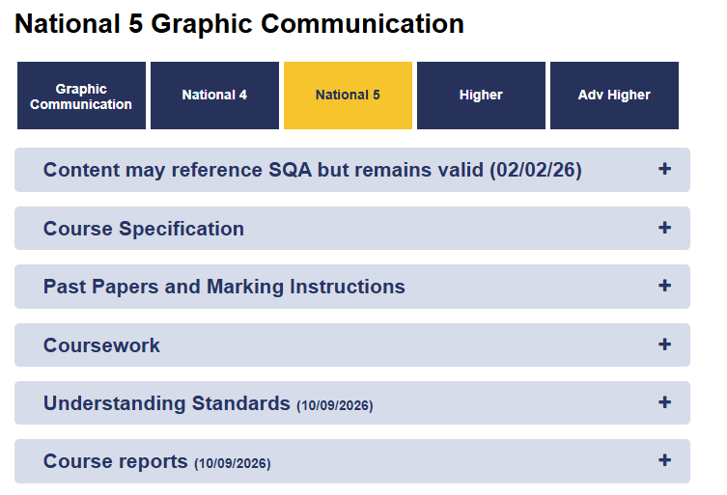
Examinable areas
Previous exams with ANSWERS!

Slide 9
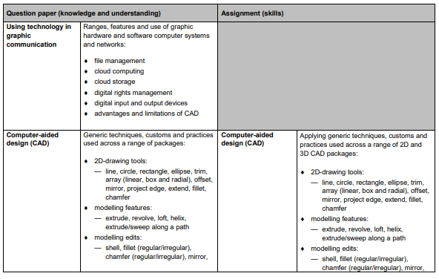
Course Specification – Revision list
Talking point
Green – confident
Red – Less confident

Slide 10
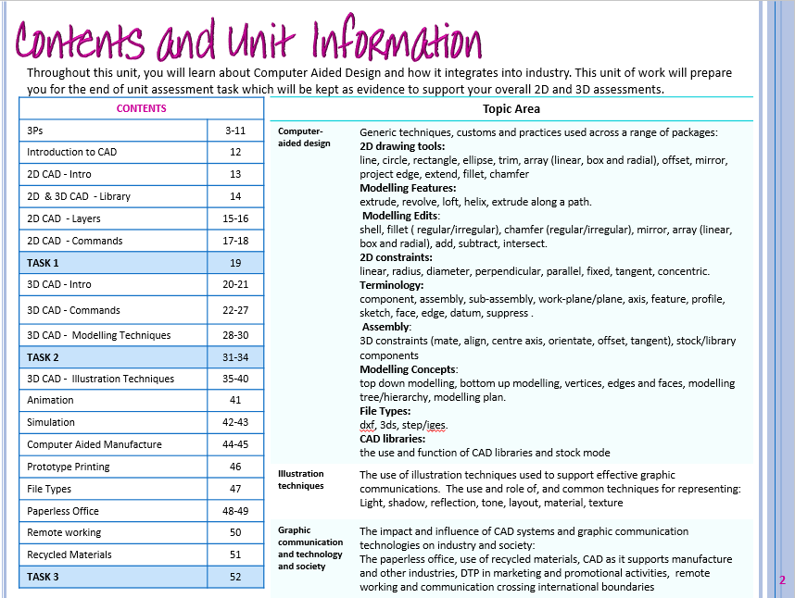
Course Specification – Revision list

Slide 11
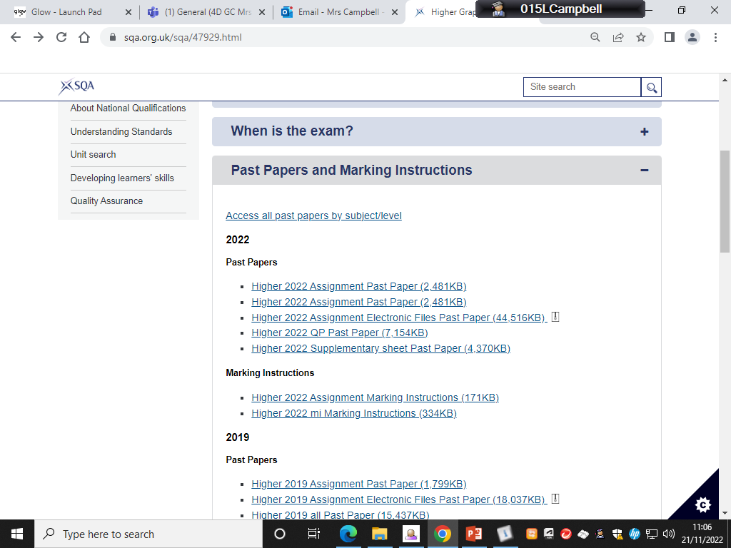
Past Papers & Marking Instructions

Slide 12
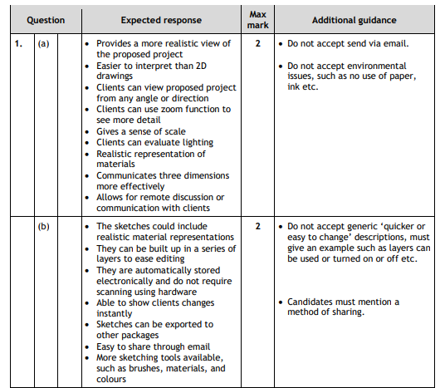
Marking Instructions
Common mistakes students may make when answering the question
Wording can be different but must have the same meaning
AI can help with this!

Slide 13
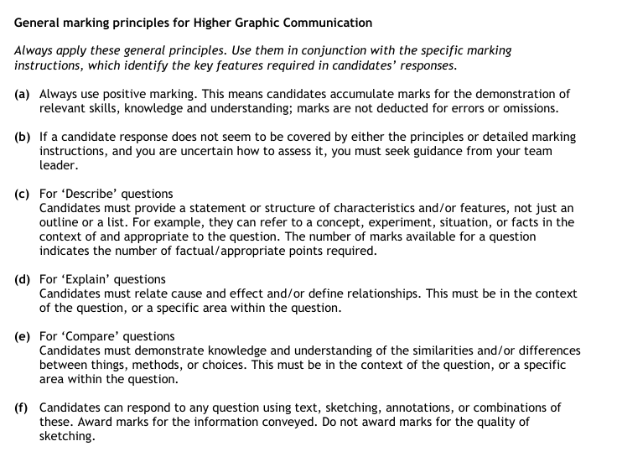
Marking Instructions
How students should answer certain questions

Slide 14
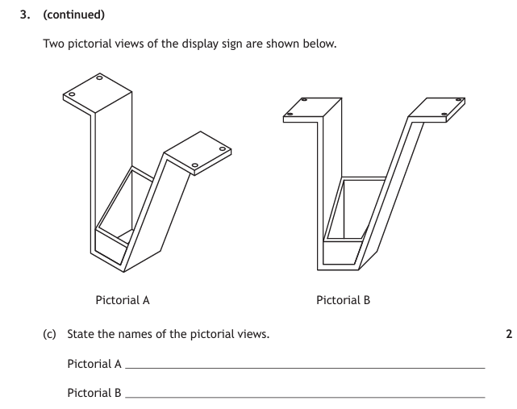
State questions – Name it!
May have additional info
Normally 1/2 marks
Should take approximately 1 MINUTE to answer
Ways to study for a STATE question
Flashcards
Quiz Quiz Trade
Kahoot
Blooket

Slide 15


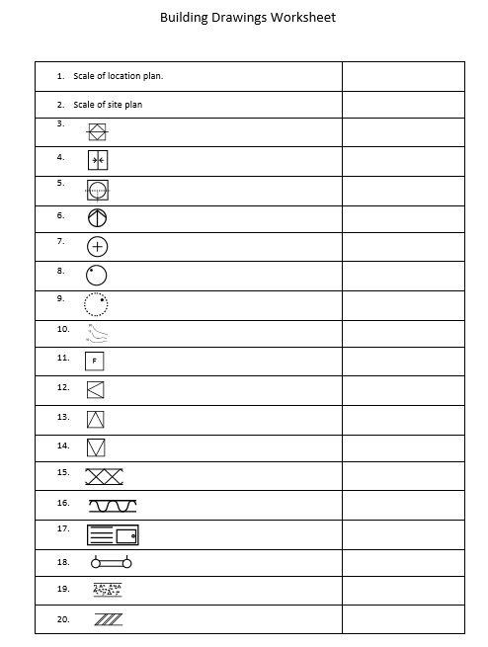
State questions – Name it!
Flashcards
Quiz Quiz Trade

Slide 16
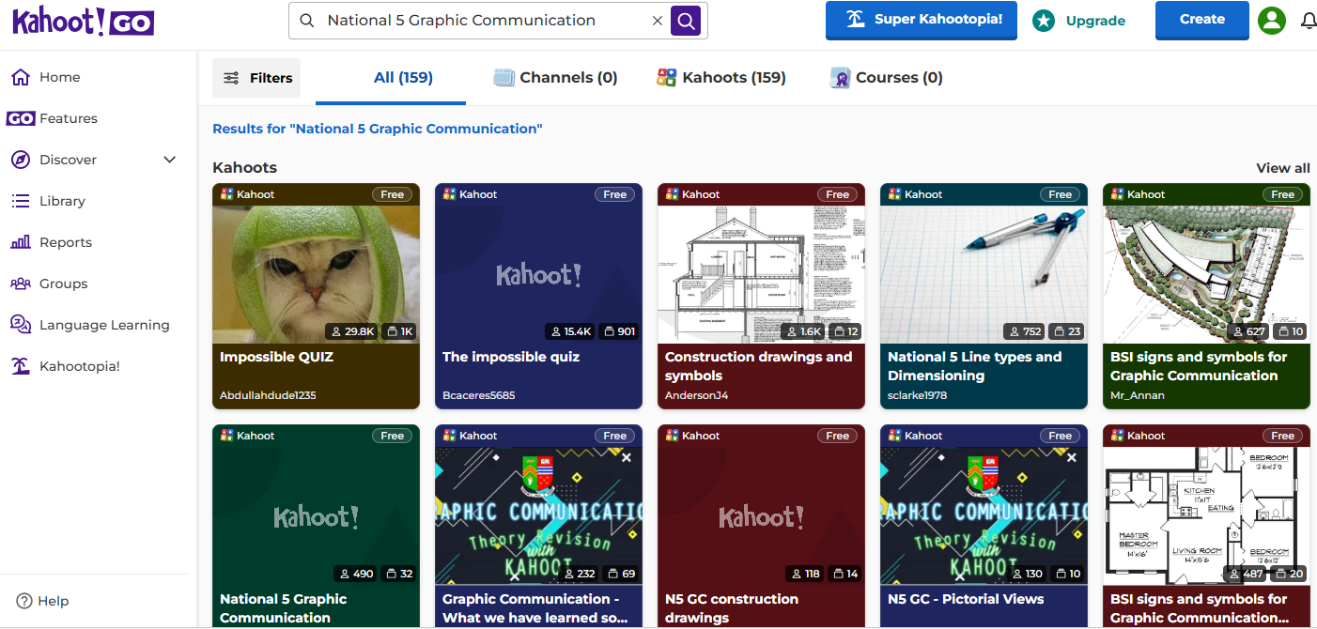
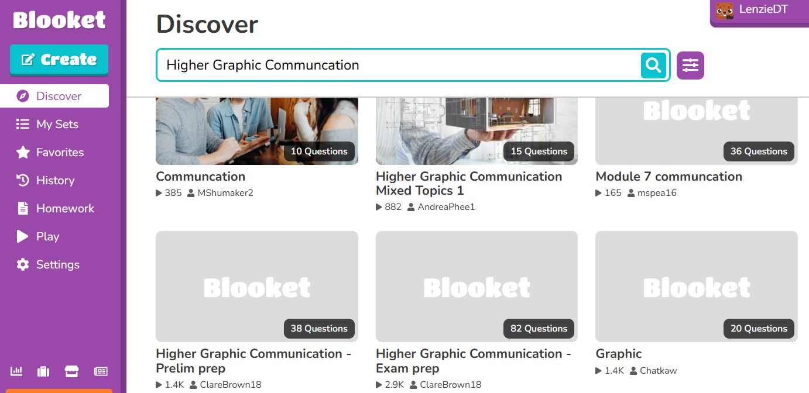
State questions – Name it!
Kahoot
Blooket

Slide 17

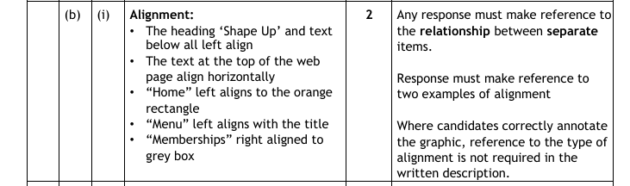
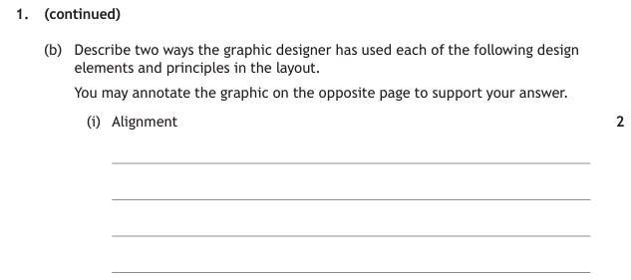
Describe questions – Say what it is or what happens
Desktop Publishing questions – 2 marks
Should take approximately 2/3 minutes to answer

Slide 18
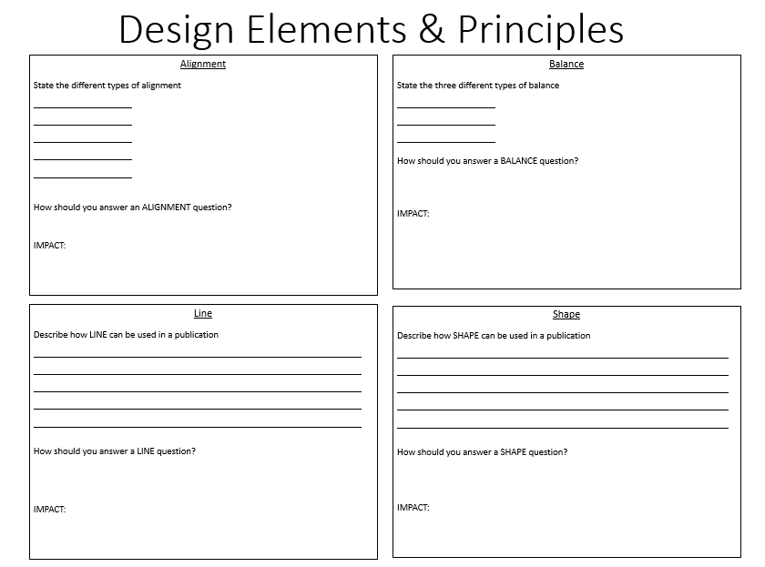
Describe questions – Say what it is or what happens
Tailored Flashcards
Ways to study for DTP DESCRIBE question
Past Papers
Tailored Flashcards
10 minute homework questions

Slide 19
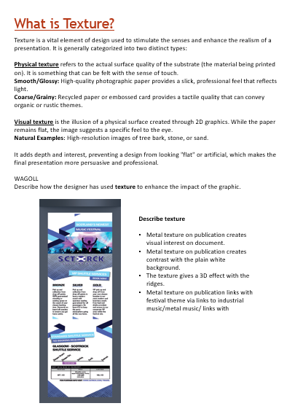
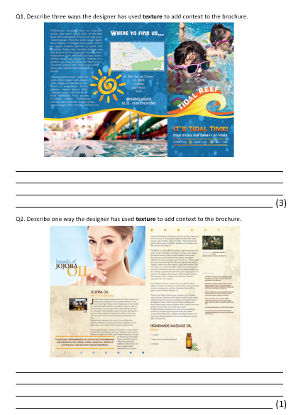
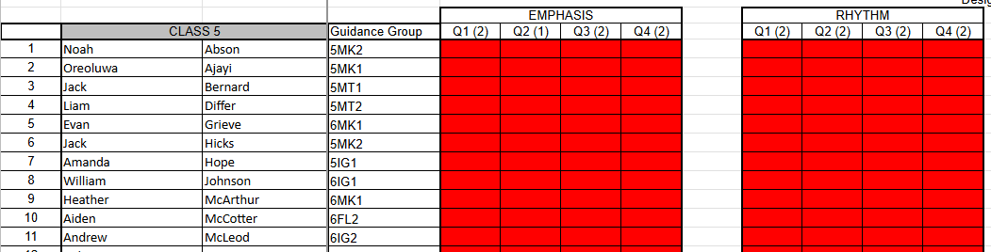
Describe questions – Say what it is or what happens
10 minute homeworks

Slide 20
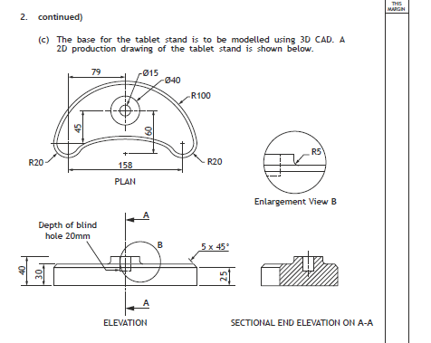
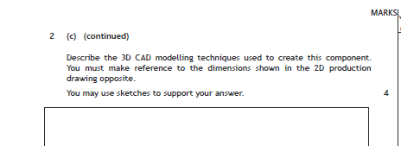
Describe questions – Say what it is or what happens
Computer Aided Design questions – can range from 2 to 6 marks
Should take approximately 5/6 minutes to answer

Slide 21
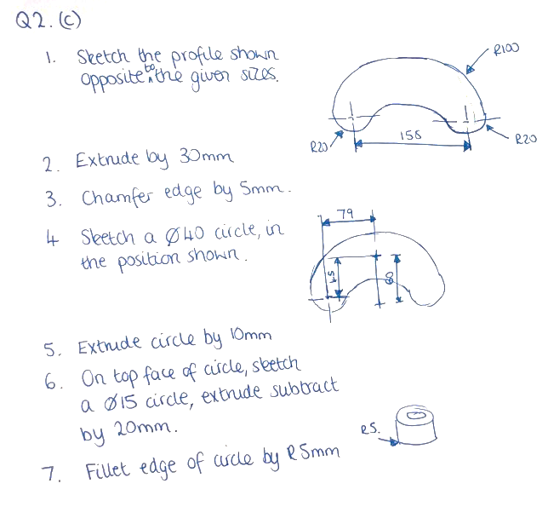
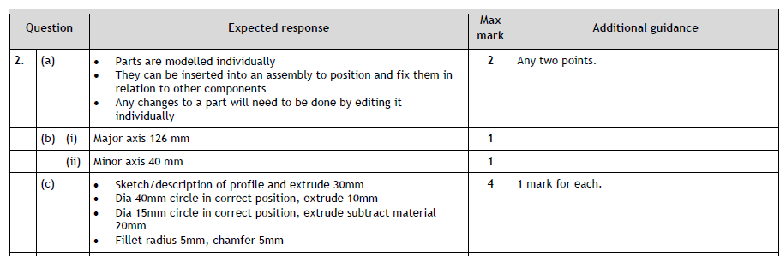
Describe questions – Say what it is or what happens

Slide 22
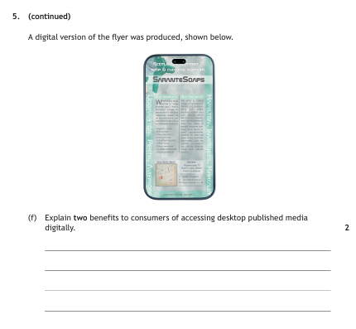
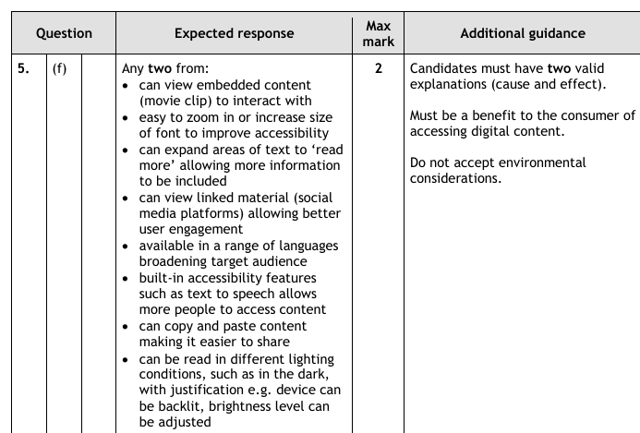
Explain questions – give a reason and show a link
Can range from 1 to 3 marks
the WHY, the BECAUSE
Should take approximately 2/3 minutes to answer

Slide 23
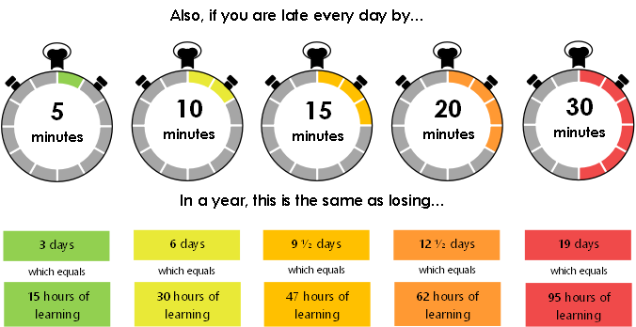
Why good timekeeping is important
A few minutes every day adds up

Slide 24
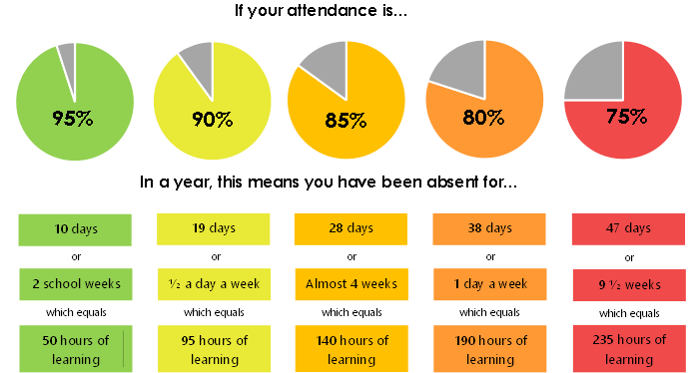
Why good attendance is important

Slide 25
Resilience
January Assessment v May exam
Nat 5 (21) - 3 As
- 6 Bs
- 4 Cs
- 6 Ds
- 2 NAs
Nat 5 - 12 As
- 5 Bs
- 2 Cs
- 2 Ds
- 0 NAs
WHY?
Higher (24)- 6 As
- 4 Bs
- 8 Cs
- 5 Ds
- 1 NAs
Higher - 14 As
- 7 Bs
- 3 Cs
- 0 Ds
- 0 NAs

Slide 26
Why?
A few things:
Need to learn how to use two software programs in addition to the course material.
Focusing on building practical skills rather than studying for exam style questions.
Just finished the course, still have a few topics to tidy up – analyse January Assessment.
Understanding the question.
Haven't quite figured out how to study effectively.
Perhaps didn't study enough, or maybe didn't study at all!
So what next…

Slide 27
So what next…
Do not feel disheartened, and do not give up.
Following the January assessment, the primary focus will shift to the assignment (worth 33% for National 5 and 36% for Higher).
During that period, there will be ten minute homework assignments most nights.
Once the assignment is complete, the focus will turn entirely to exam-style questions, tackling one topic at a time.
AND WE DON’T, I REPEAT WE DON’T GIVE UP!!

Slide 28
Any questions…

Slide 29
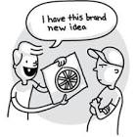
School context
The Learning and Teaching committee is working with Osiris Educational
Focus on visible learning, mindsets, metacognition, building resilience.
OUR AIM: is to have metacognition and effective feedback strategies embedded into our school curriculum.

Slide 30
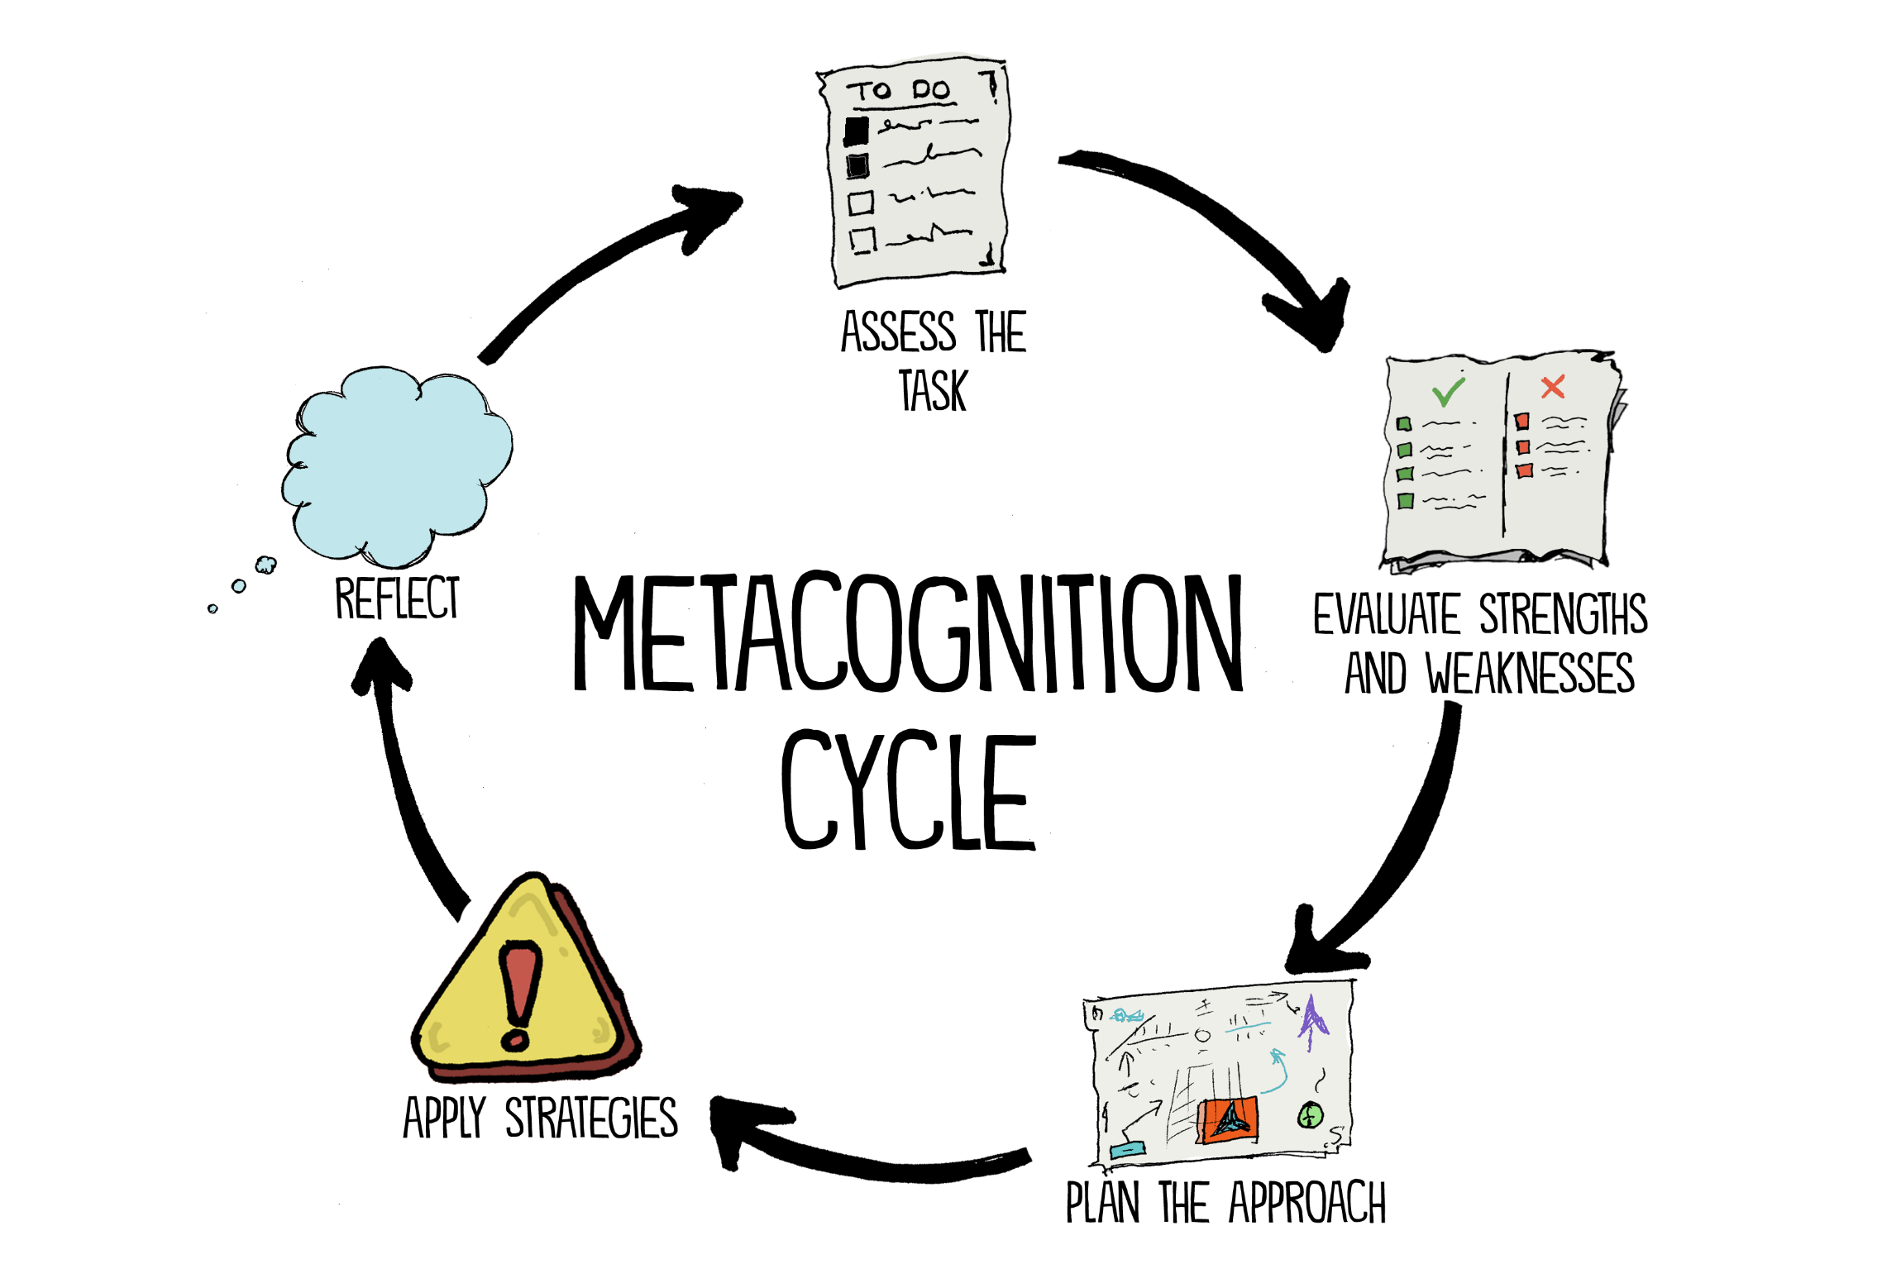

‘Thinking about one’s thinking’

Slide 31
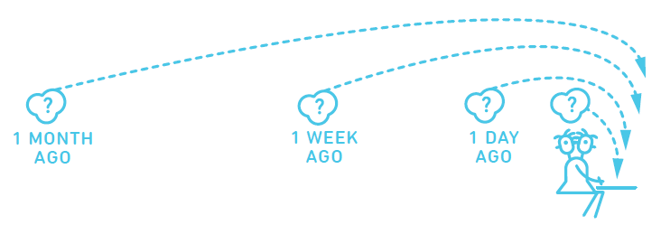
Spaced Practice
A little bit of time every day
Review information from each class, but not immediately
Use active retrieval practice strategies, not just reading notes

Slide 32
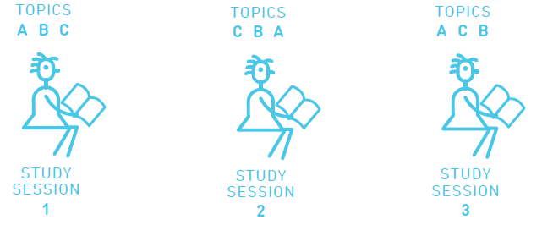
Interleaving
Switching between ideas during a study session.
Not studying one idea for too long
Go back over the ideas again in different orders to strengthen understanding

Slide 33

Retrieval Practice
Actively retrieving information from memory without the support of class notes or revision booklets

Slide 34

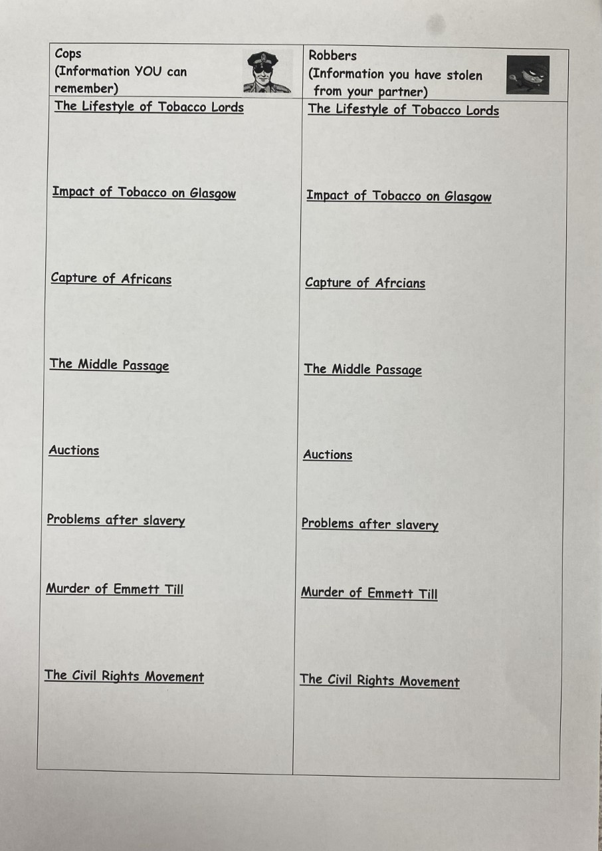

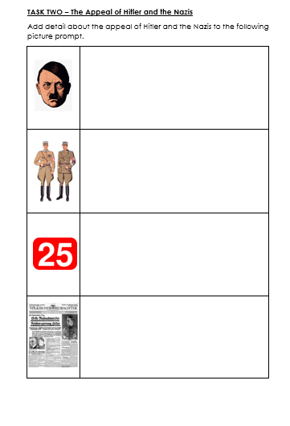
Brain dump
Picture prompt
Cops and robbers

Slide 35
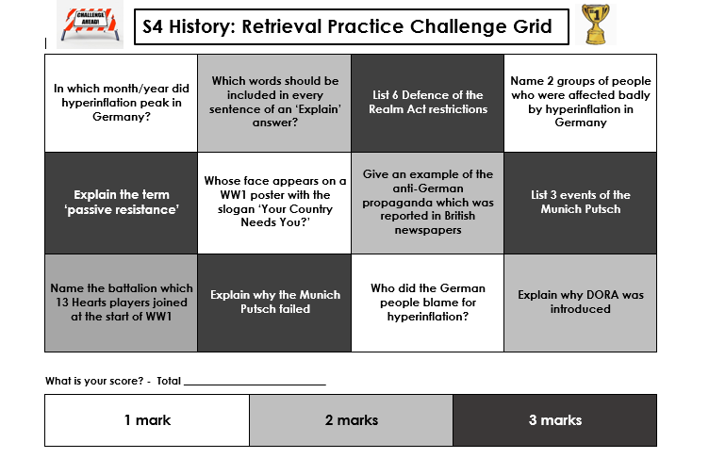
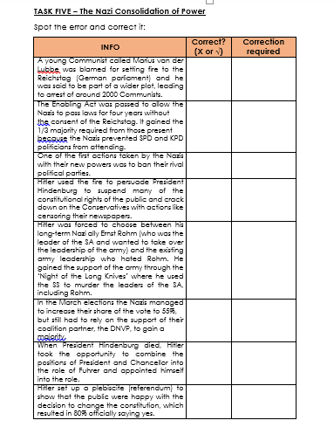
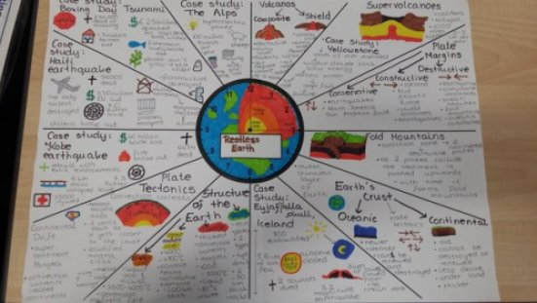
Spot the error
Challenge grid
Revision clocks

Slide 36
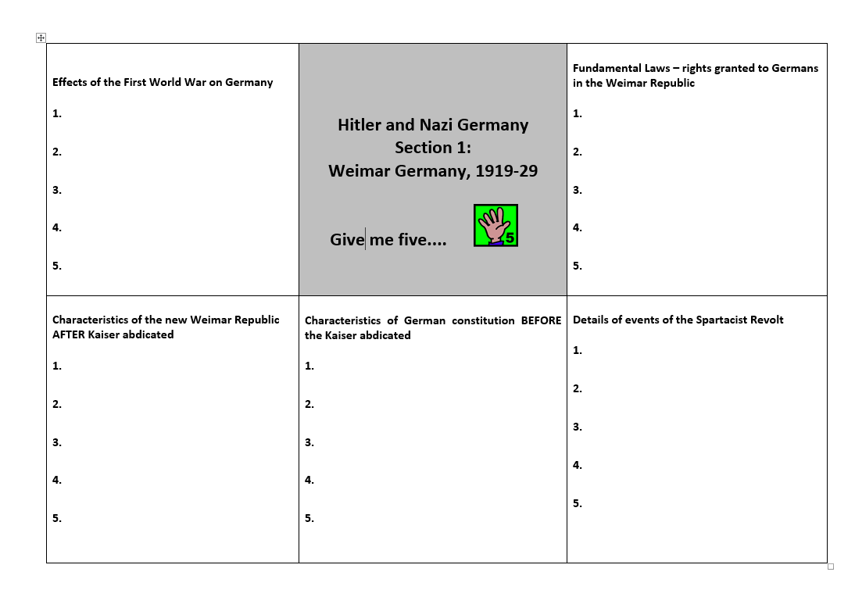
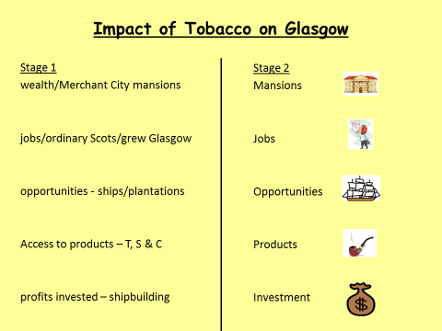
Give me 5
Flashcards

Slide 37

Supporting revision at home through retrieval practice:
Flashcards
Quizzing
Supporting ‘brain dumps’ – checking for accuracy
Practice questions – checking answers

Slide 38
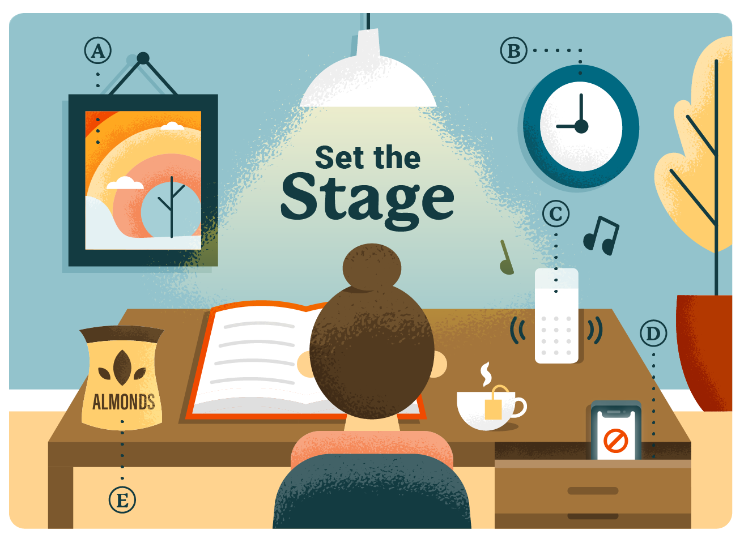
Stick with an environment that works
Inform family and friends
Schedule set study times
Remove distractions
Be organised
Listen to calming music

