Slide 1

National 5
Administration & IT
Family Learning 2026

Slide 2

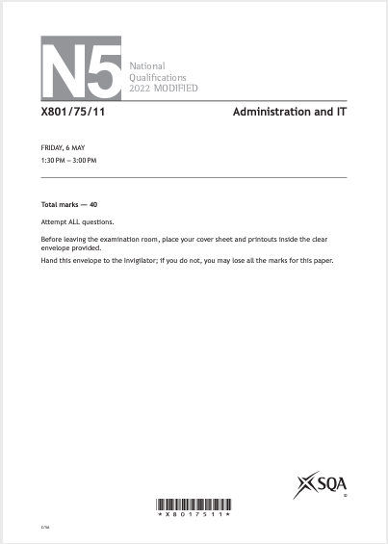

Course Information
Final grade will be made up of two parts:
Question Paper (Final exam)
50 marks (42% final grade)
2 hours
2. Assignment (Done in school)
70 marks (58% final grade)
2 sittings
1 hour 30 minutes each

Slide 3
Course Overview
IT Applications
Theory

Slide 4
Course Overview
IT Solutions - Spreadsheets
Count
Count A
Mixed formula
IF Statements
Naming Cells
Absolute Cells
Charts
Printing
Administrative Theory in the Workplace
The role of the Administrative Assistant
Customer Service
Health and Safety
Security of People, Property and Information
IT Solutions - Databases
Queries – Not, Or, And, Null, <>,
Creating labels
Creating forms
Creating reports
Communication in Administration
Sources of Information
Variety and reliability of sources
File Management
IT Solutions – Word Processing and Presentations
WP documents – letters, forms, itineraries, meetings documents, reports, minutes, posters,, leaflets, booklets and newsletters
Presentations – editing, importing information, master slides, graphics, formatting
Email
Electronic Tasks/Tod Do lists
E-diary
Internet Research
Methods of communication

Slide 5
Further Course Information
QS Website:
https://www.sqa.org.uk/sqa/47435.html
(Includes info on Course Specification, Assignment, Past Papers, etc)
SQA Understanding Standards
https://www.understandingstandards.org.uk/Subjects/Administration/national5/
(Gives info on Candidate Evidence)

Slide 6
Resources
Lenzie Academy (Notes, Tasks, Homework, Revision Packs) - All uploaded to Teams
QS Past Papers
Achieve - https://achieve.hashtag-learning.co.uk/user-start/?next=/

Slide 7
Command Words
Describe
Explain
Outline/Suggest
Compare
The theory questions are roughly 7-13 marks.
These marks could make the difference between an A, B or C

Slide 8
Common Spreadsheet Formulae
IF Statements – logic functions allow us to make comparisons between values, so the answer is always True or False based on criteria.
SUM - this formula allows us to total numbers together in one go instead of adding multiple cells over and over again.
Percentages – within questions pupils are often asked to calculate percentages to figure out the right answer. (Pupils will always be given the information within comments)
Averages / Minimums / Maximums – where pupils have to identify the lowest, highest and average based on a set of numbers.

Slide 9


Question Paper Top Tips
Exam is 2 hours
The mark allocation is broken down by:
  20 marks (+/-3) for spreadsheets
  20 marks (+/-3) for databases
  10 marks (+/-3) for theory
At the beginning of each paper, the questions are split into a table highlighting the type of question (eg. Spreadsheet: formulae view and value view) alongside the marks and a box to tick completed
We would recommend that pupils tick the box once completed and printed
Answer every question in the paper in the exact order – as some questions make you refer back
Always read the information above the question as it might give you valuable details which you have to use in the task
Highlight/circle key information from the task to ensure you have all the correct information for your printout
Remember to always have your name printed on the footer alongside the task number eg. William Forrest, task 1b
​Keep thinking about timing – make sure to progress through each task with enough time to complete

Slide 10

Assignment Information - March
This assignment is worth 70 marks. This is 58% of the overall marks for the course assessment.
The assignment will be sat over two 1 hour 30 minute sittings. As for the question paper, pupils should always work through the tasks in order to ensure no important information is missed.
For assignment preparation, we will spend a lot of time revising and going over past assignment papers to ensure everyone is familiar with the layout, timing, and expectations.
We would recommend, if possible, to continue self-study at home by practicing questions at home by downloading the past papers and e-files from the SQA website directly.
Top Tip: At the end of the first sitting, review the rest of the paper to ensure you know exactly what is coming up and what to revise at home before the second sitting.
This Photo by Unknown Author is licensed under CC BY

