Slide 1


QS Family Learning Event
National 5
Chemistry
Ms Sood
Teacher of Chemistry

Slide 2
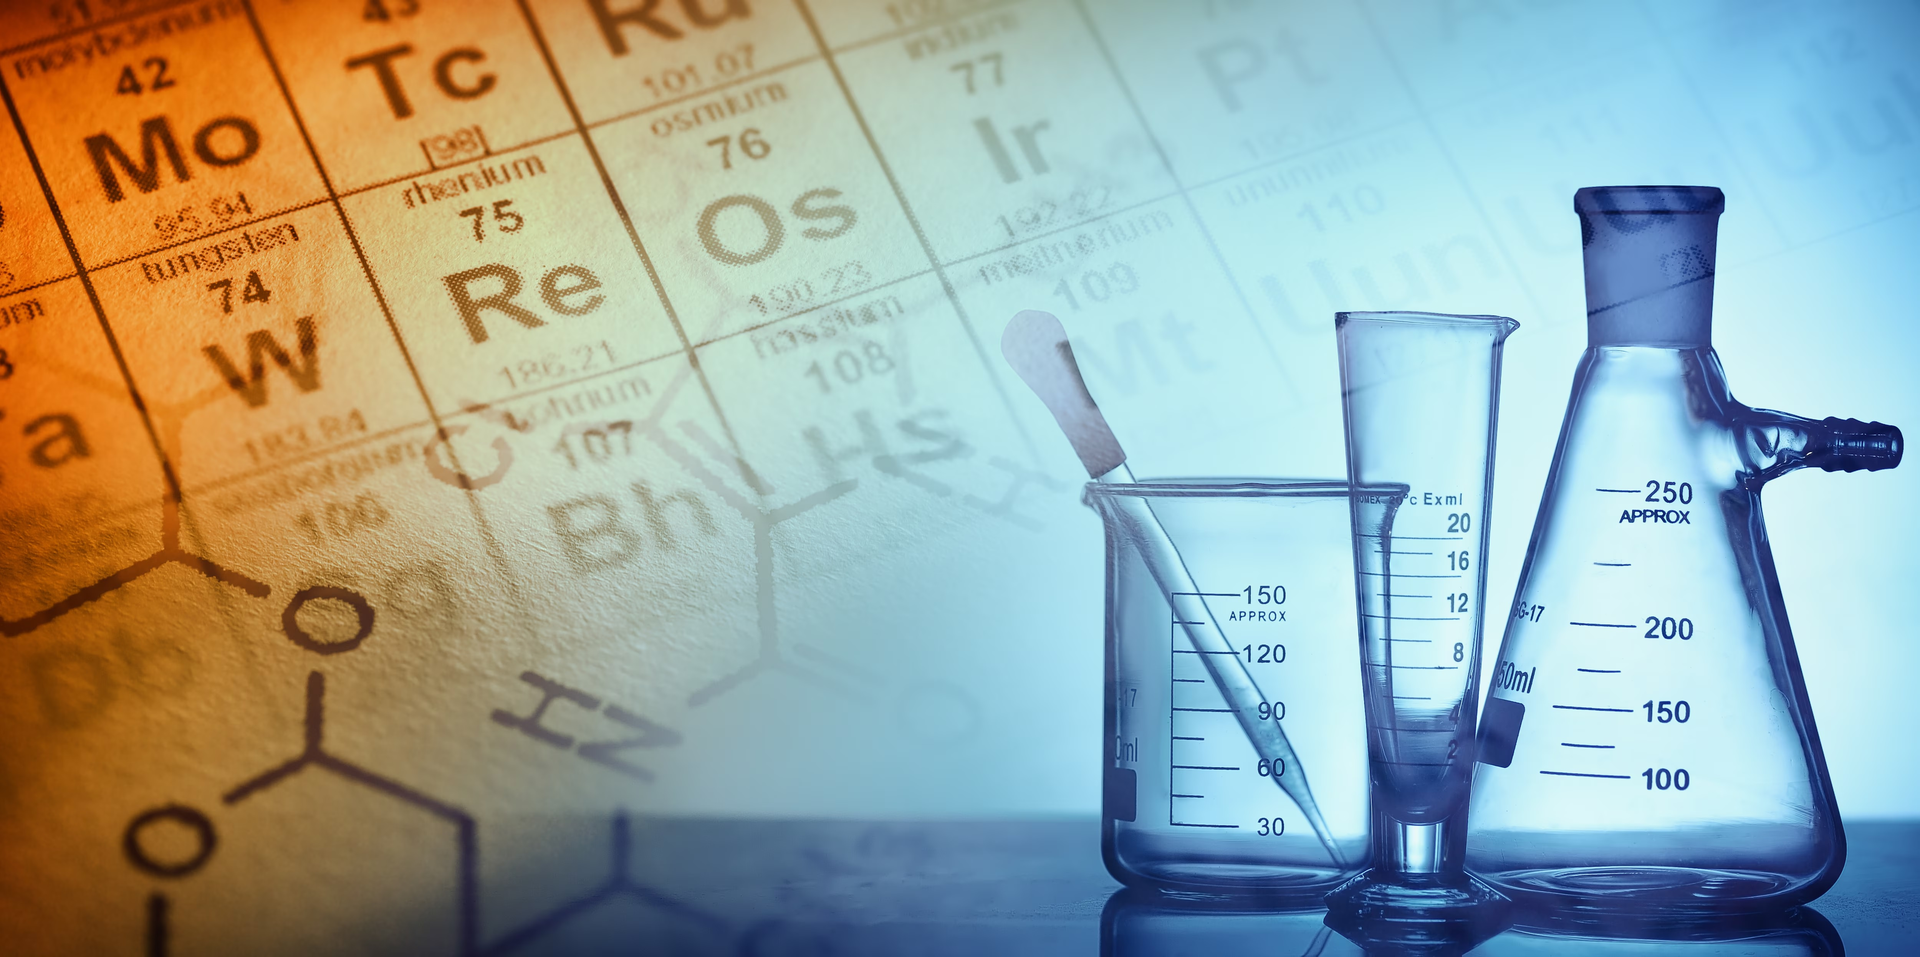



Information
Course Content
Exam
Revision

Slide 3
Course Content
Unit 1
Atoms & the Periodic Table
Rates of Reactions
Compounds, Chemical Formulae & Calculations
Structure, Bonding & Properties
Acids & Bases
Unit 2
Homologous Series
Everyday Consumer Products
Energy From Fuels
Unit 3
Metals
Plastics
Fertilisers
Nuclear Chemistry
Chemical Analysis

Slide 4
Exam
Written Exam (80 %)
Section 1 – Multiple Choice
  20 Questions
  20 Marks
Section 2 – Written Answers
  60 Marks
Duration – 2 hours
Aim to spend 1.5 minutes per mark.
Two ‘Using your knowledge’ questions.
Assignment (20 %)
20 Marks
Two weeks spent in class
  Experiment carried out in class.
  Prepare for written report.
Written report will be completed in class under exam conditions.
Two periods to write the report (double period used).

Slide 5

Revision

Slide 6
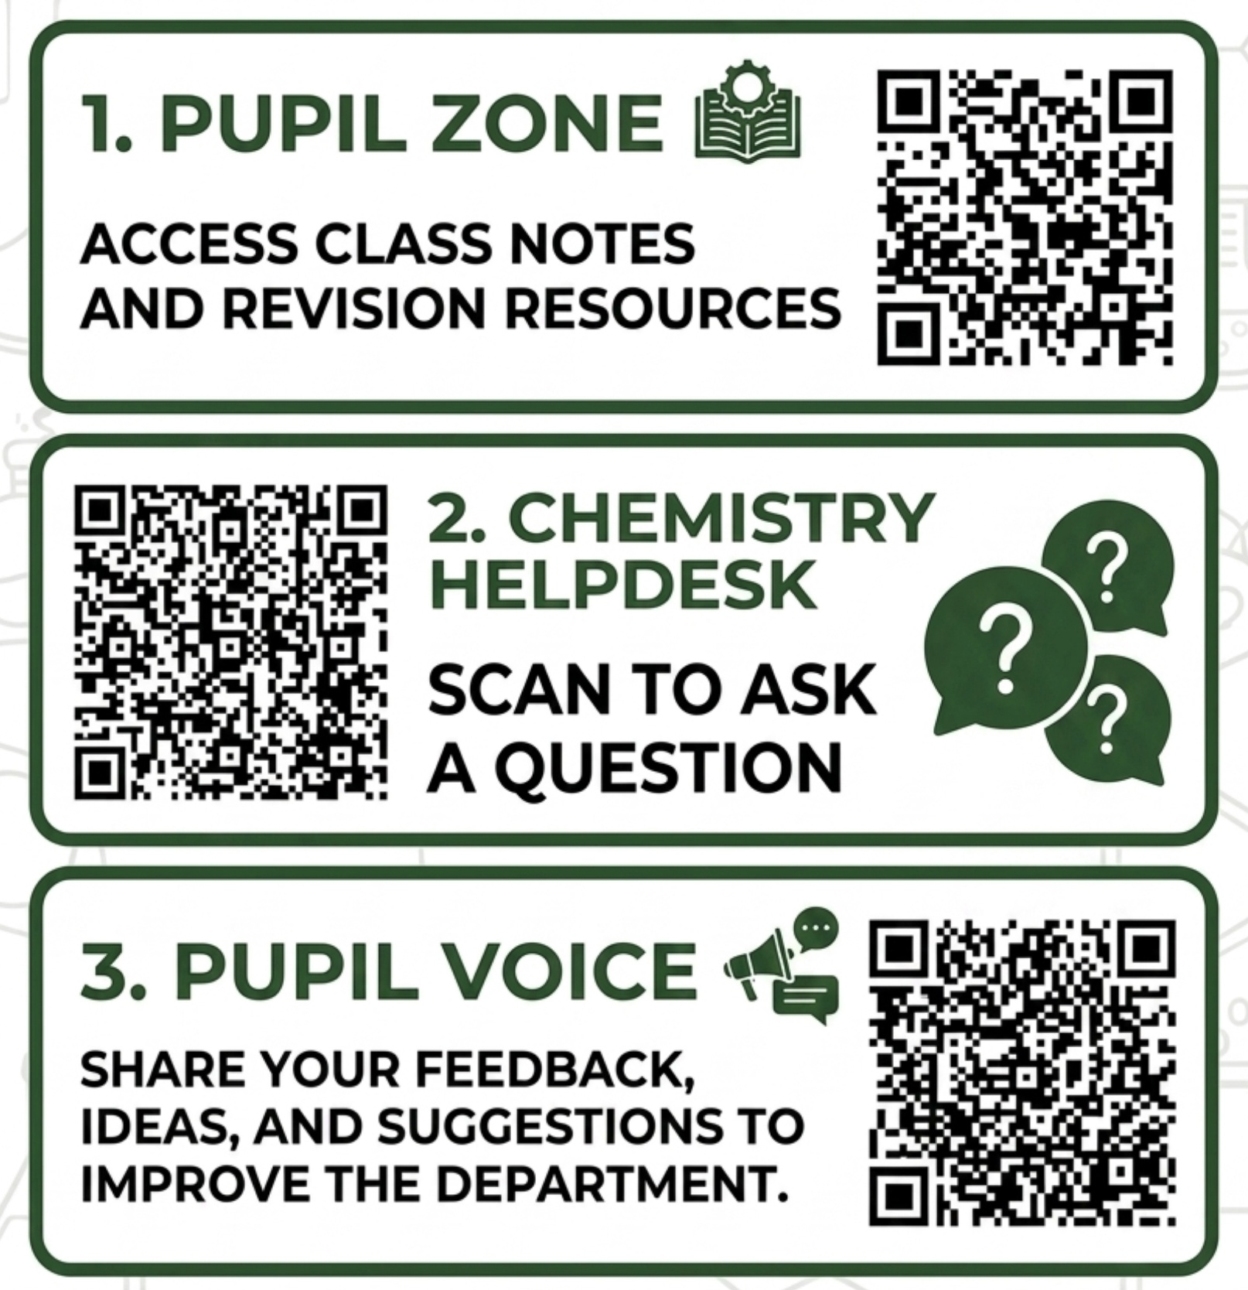

Slide 7


