Slide 1

Lenzie Academy Physics Department
Preparing your child for QS Exams
Higher Physics
15th September 2026

Slide 2

Higher Course Structure
3 Units:
1. Our Dynamic Universe (Finish in October)
2. Electricity (Finish in December)
3. Particles and Waves (Finish in March)
80% of the course is based on the final exam and 20% on the assignment task which will be completed in class in February.
An in-class revision programme will begin once the course is completed around mid-March.
Ambition •
Lenzie Academy
•
Inclusion
Physics Department

Slide 3
Exam Structure
Prelim in January – covers all of Unit 1 and 2. This is used for QS estimates and evidence.
Final exam date: Tuesday 4th May 2027
09:00 – 11:30 (2 hours 30 minutes)
Exam Format (One paper):
Section 1 – 20 marks of multiple-choice questions.
Section 2 – 110 marks of extended answer questions.
Ambition •
Lenzie Academy
•
Inclusion
Physics Department

Slide 4
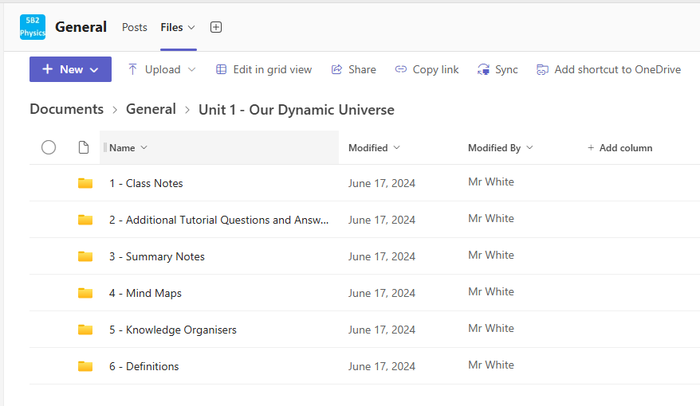
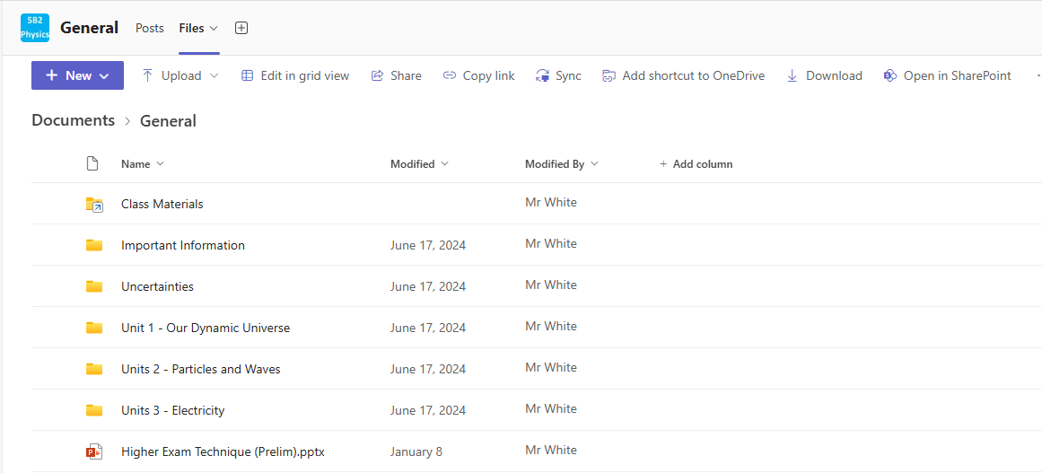
Teams Pages
Ambition •
Lenzie Academy
•
Inclusion
Physics Department

Slide 5
Revision Advice
Select area of course for revision (e.g. Gravitation)
Read and review notes on that area (flashcards, mind maps, summary notes)
Ambition •
Lenzie Academy
•
Inclusion
Physics Department

Slide 6
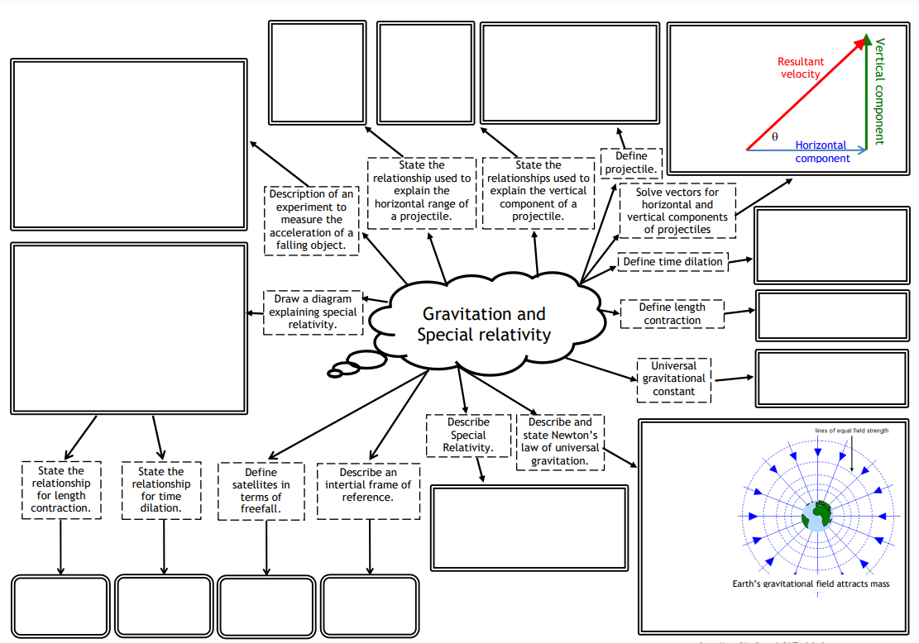
Example: Mind Maps
Ambition •
Lenzie Academy
•
Inclusion
Physics Department

Slide 7
Revision Advice
Select area of course for revision (e.g. Gravitation)
Read and review notes on that area (flashcards, mind maps, summary notes)
Try the associated problems (tutorials and then past papers)
Ambition •
Lenzie Academy
•
Inclusion
Physics Department

Slide 8
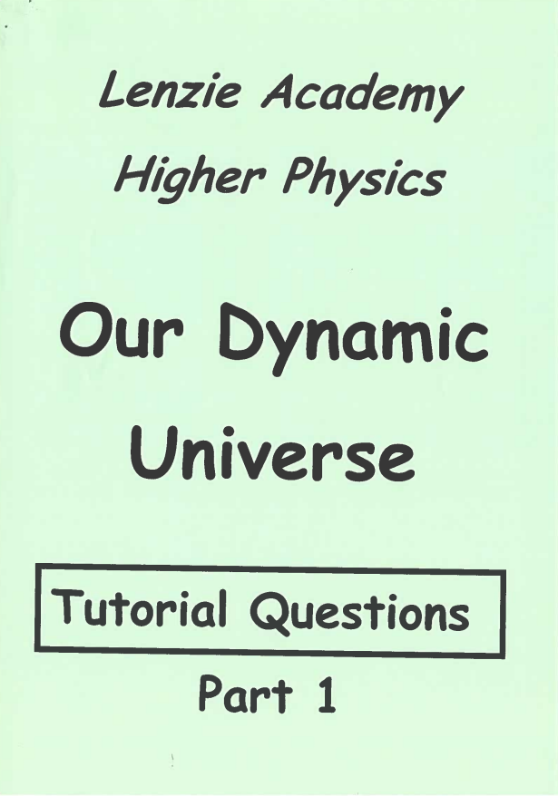
Tutorials
All pupils given physical booklets with answers on the back pages.
Problem practice is key to success in Physics.
Increasing in difficulty with some past paper questions at the end.
Digital copies on the class Teams pages.
Ambition •
Lenzie Academy
•
Inclusion
Physics Department

Slide 9
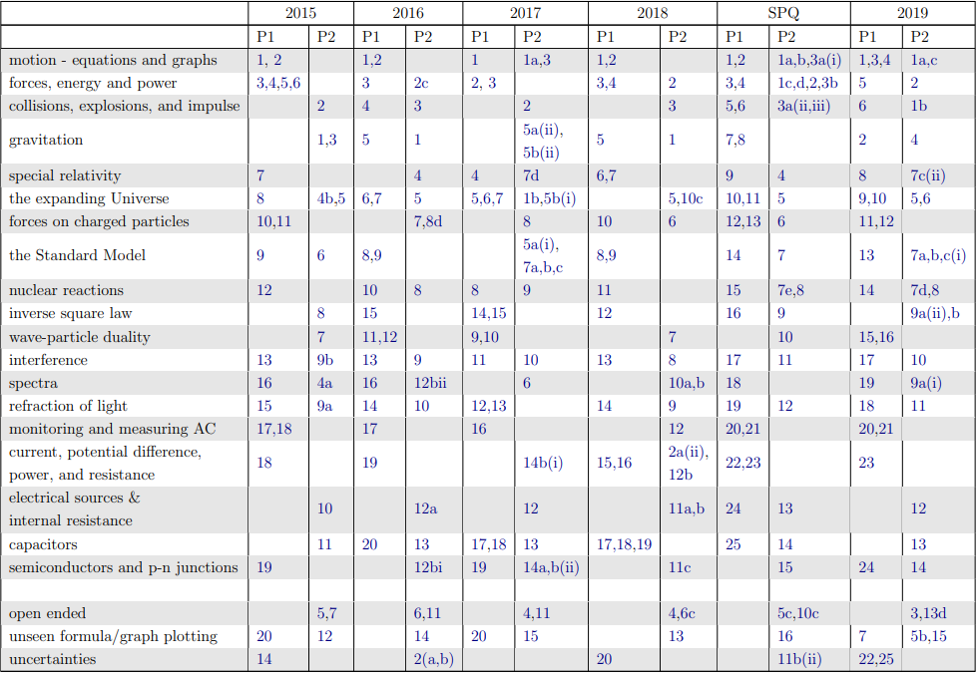
Past Papers
Ambition •
Lenzie Academy
•
Inclusion
Physics Department

Slide 10
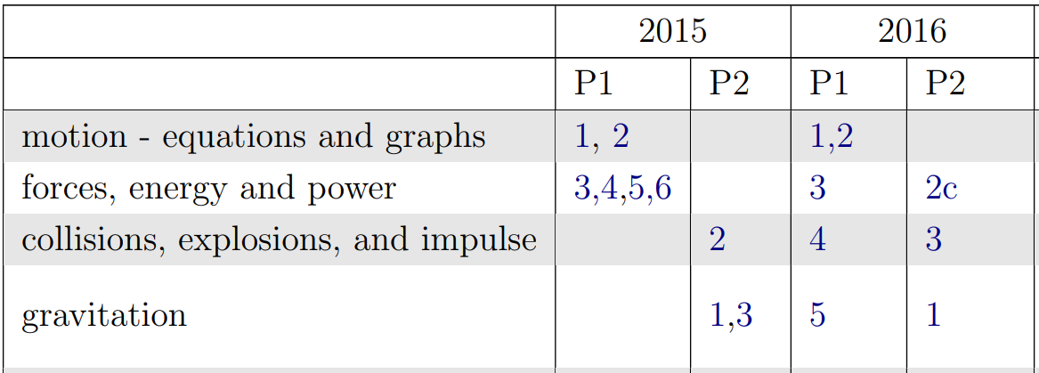
Past Papers
Full past papers and a link to old past papers is provided on class Teams pages.
Ambition •
Lenzie Academy
•
Inclusion
Physics Department

Slide 11
Revision Advice
Select area of course for revision (e.g. Gravitation)
Read and review notes on that area (flashcards, mind maps, summary notes)
Try the associated problems (tutorials and then past papers)
Log progress with QS course check list
Ambition •
Lenzie Academy
•
Inclusion
Physics Department

Slide 12
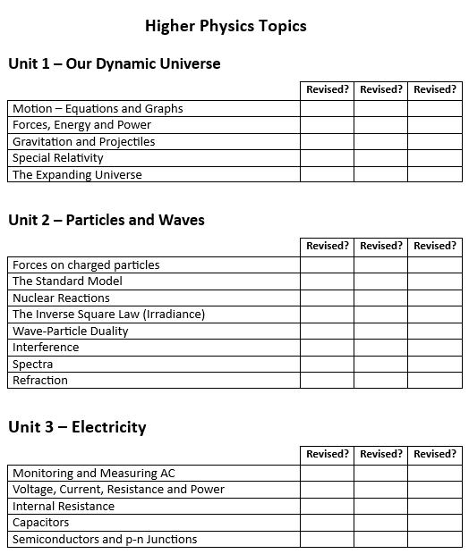
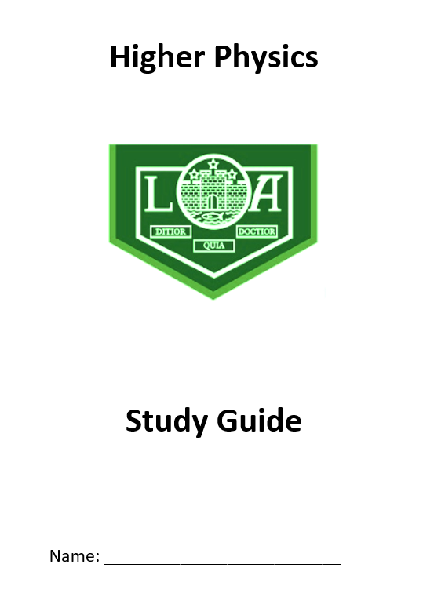
Course Checklist
Ambition •
Lenzie Academy
•
Inclusion
Physics Department

Slide 13
Revision Advice
Select area of course for revision (e.g. Gravitation)
Read and review notes on that area (flashcards, mind maps, summary notes)
Try the associated problems (tutorials and then past papers)
Check knowledge with QS course check list
Move on to the next area.
Complete full past papers (timed) and log results.
Ambition •
Lenzie Academy
•
Inclusion
Physics Department

Slide 14
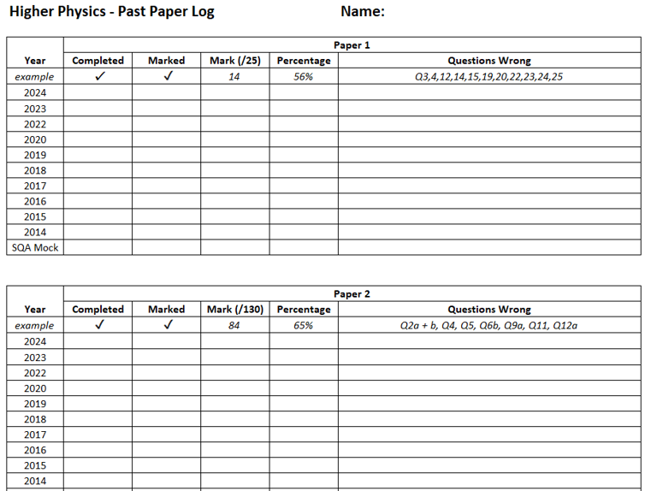
Past Paper Tracker
Ambition •
Lenzie Academy
•
Inclusion
Physics Department

Slide 15
Additional Support
Supported Study
Will take place weekly closer to the exams – sign up sheets outside S13.
Come with questions.
Lunchtime Drop-in (1:10 – 1:50)
Any member of the Physics department will be able to help but please ensure pupils come prepared with questions.
In-Class Revision Programme (February-April)
Approx. 5 weeks in class where pupils will have time to ask for assistance.
Ambition •
Lenzie Academy
•
Inclusion
Physics Department

Slide 16
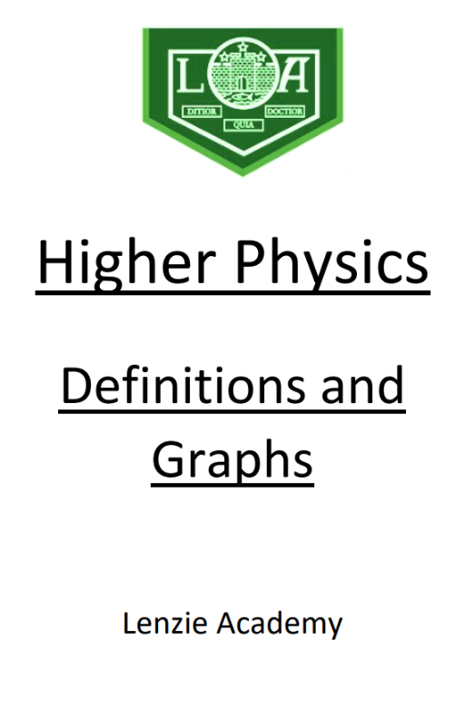
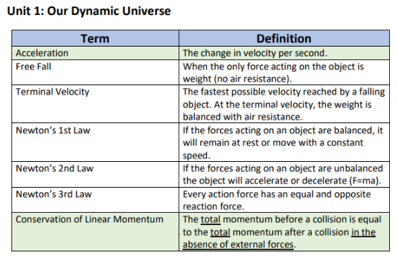
Definitions and Graphs
Ambition •
Lenzie Academy
•
Inclusion
Physics Department

Slide 17
Things you can do at home
To support your child with Physics you could:
Encourage them to complete the past papers and monitor their progress using the highlighted checklist or past paper log.
Review the advice in the pupil's study guide booklet and encourage your child to follow the guidance.
Help them recall equations and definitions by reading terms on the definition sheets (on Teams) and asking them to respond.
Check mind maps and use them to ask your child questions.
Ambition •
Lenzie Academy
•
Inclusion
Physics Department

Slide 18
Any Questions?
Thank you for attending!

