Slide 1
Supporting Your Child Through QS
Examinations

Slide 2

Finding the Correct Environment
Find a dedicated and consistent workspace, this could be in the house, or some pupils like to get out to libraries etc for this.
Create a study schedule and timings that suit the individual, people will study more efficiently at different times of the day.
Try and remove any distractions (phones, consoles, devices etc).
Create a strategy/system that will work.
Take regular breaks and promote the pupil to do things they enjoy in free time.

Slide 3
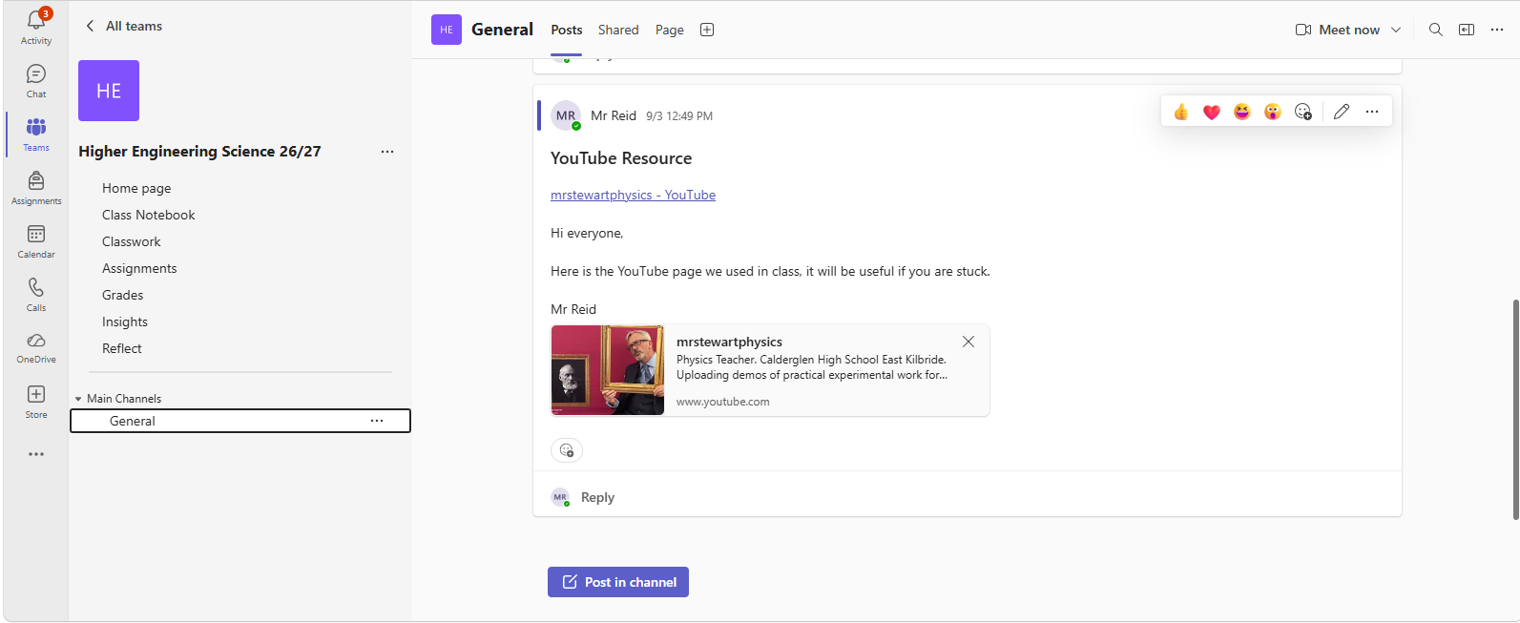
Resources/Contact with Teacher out with School
Resources/Tasks Posted Here
Microsoft Teams
Assignments/Homework
Information Posted by Teacher and Class Communication in Replies

Slide 4
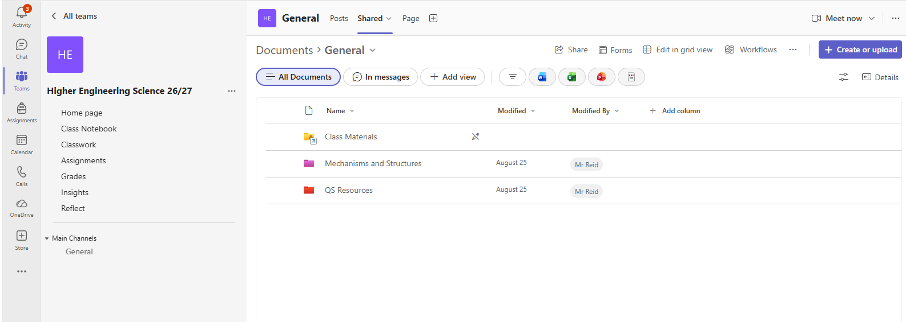
Teams
Class Resources are Uploaded in the SHARED Section of the class Teams Page. These are updated regularly throughout the year. Can be used to study or catch up on anything missed in class etc.

Slide 5
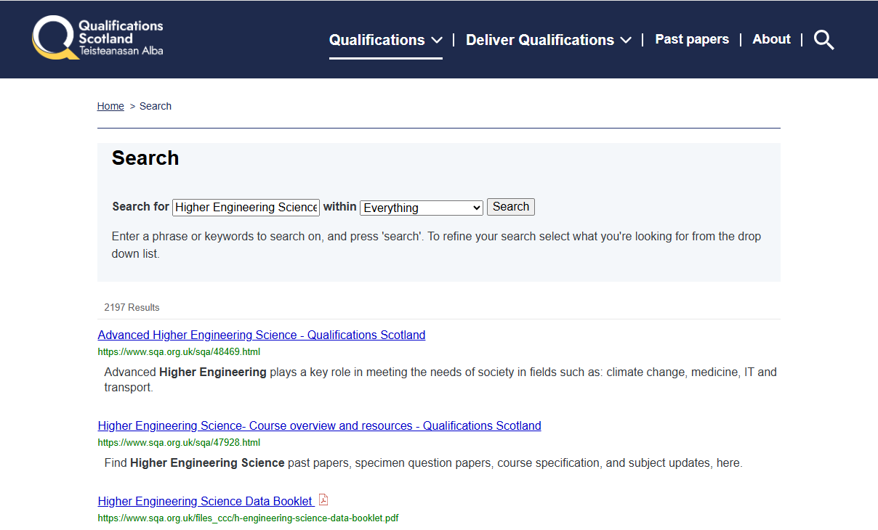
QS Site
Search any subject and level here.
Takes you to all course info.

Slide 6
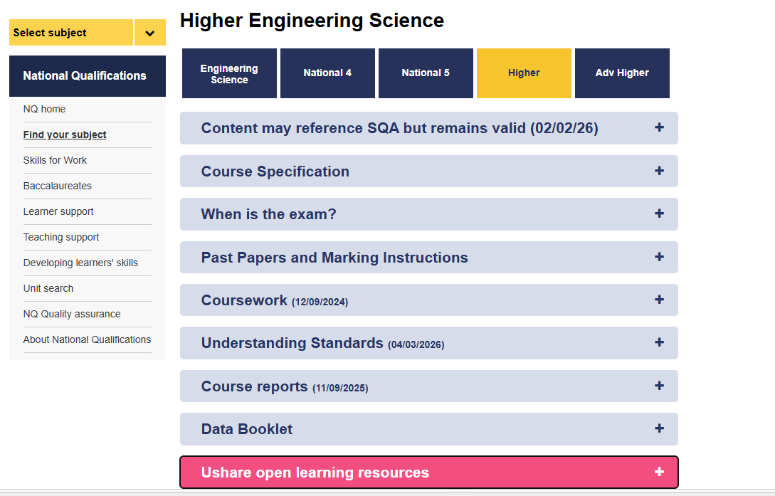
QS Engineering Science Page
Examinable Content
Past Papers and Marking Instructions, I find this to be one of the most important ways to study.
New useful links for Questions/Tasks/Notes that Pupils can use to study.

Slide 7
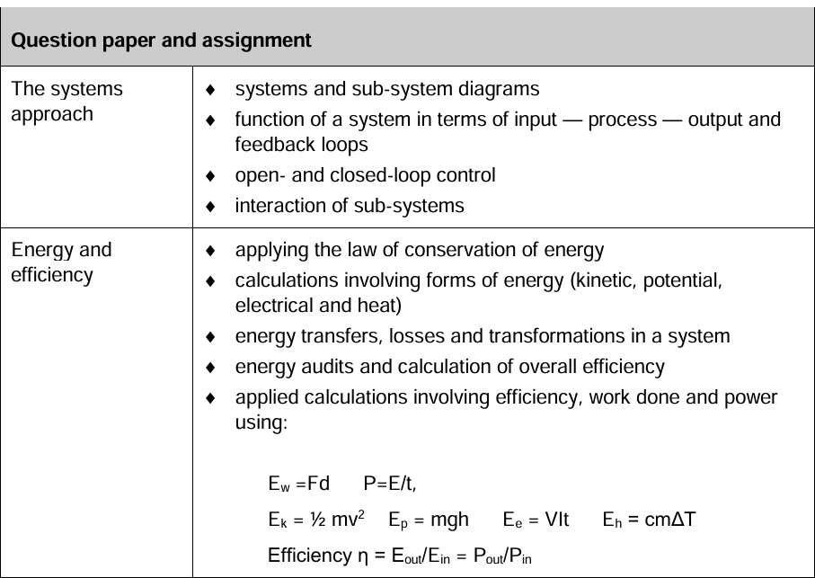
Course Specification
The Course Spec gives information about the course like the breakdown of assessment between Assignment (50 Marks) and Question Paper (110 Marks).
It goes over all topics and content that pupils need to know for their exams/assignments.
These can be used as Revision Checklists and can be coloured coded on areas of strength and areas that need work.

Slide 8
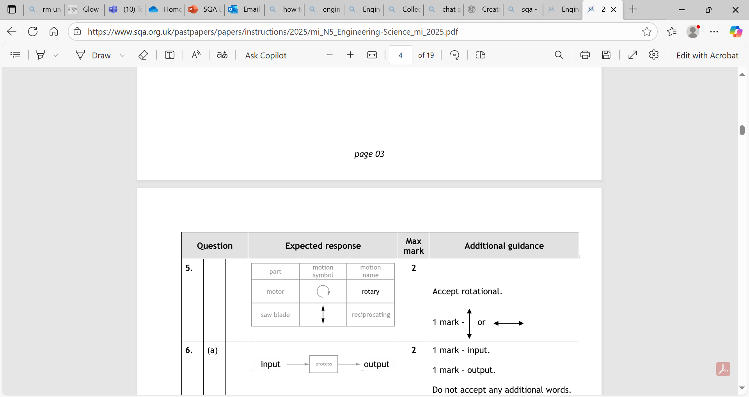
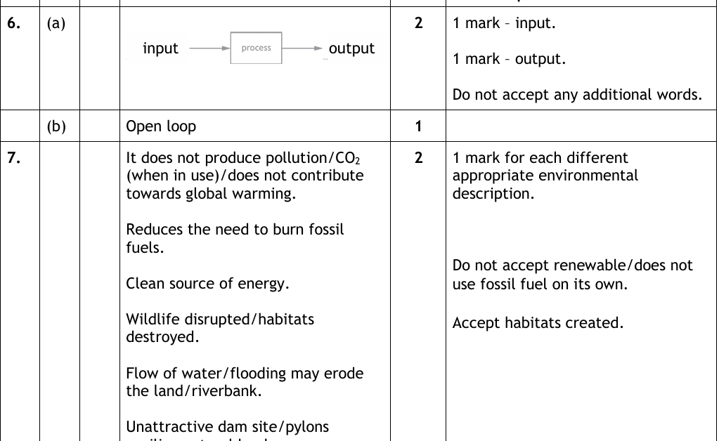
Marking Instructions
Common mistakes SQA look for, also gives guidance on how each mark is given out or any additionally accepted answers.
Here are the expected answers, these can be worded differently unless a STATE question.

Slide 9

Exam Date
National 5 – Friday 28th May 2027 @ 13:00 – 14:45
Higher – Friday 28th May 2027 @ 13:00 – 15:30

Slide 10

School context
The Learning and Teaching committee is working with Osiris Educational
Focus on visible learning, mindsets, metacognition, building resilience.
OUR AIM: is to have metacognition and effective feedback strategies embedded into our school curriculum.

Slide 11
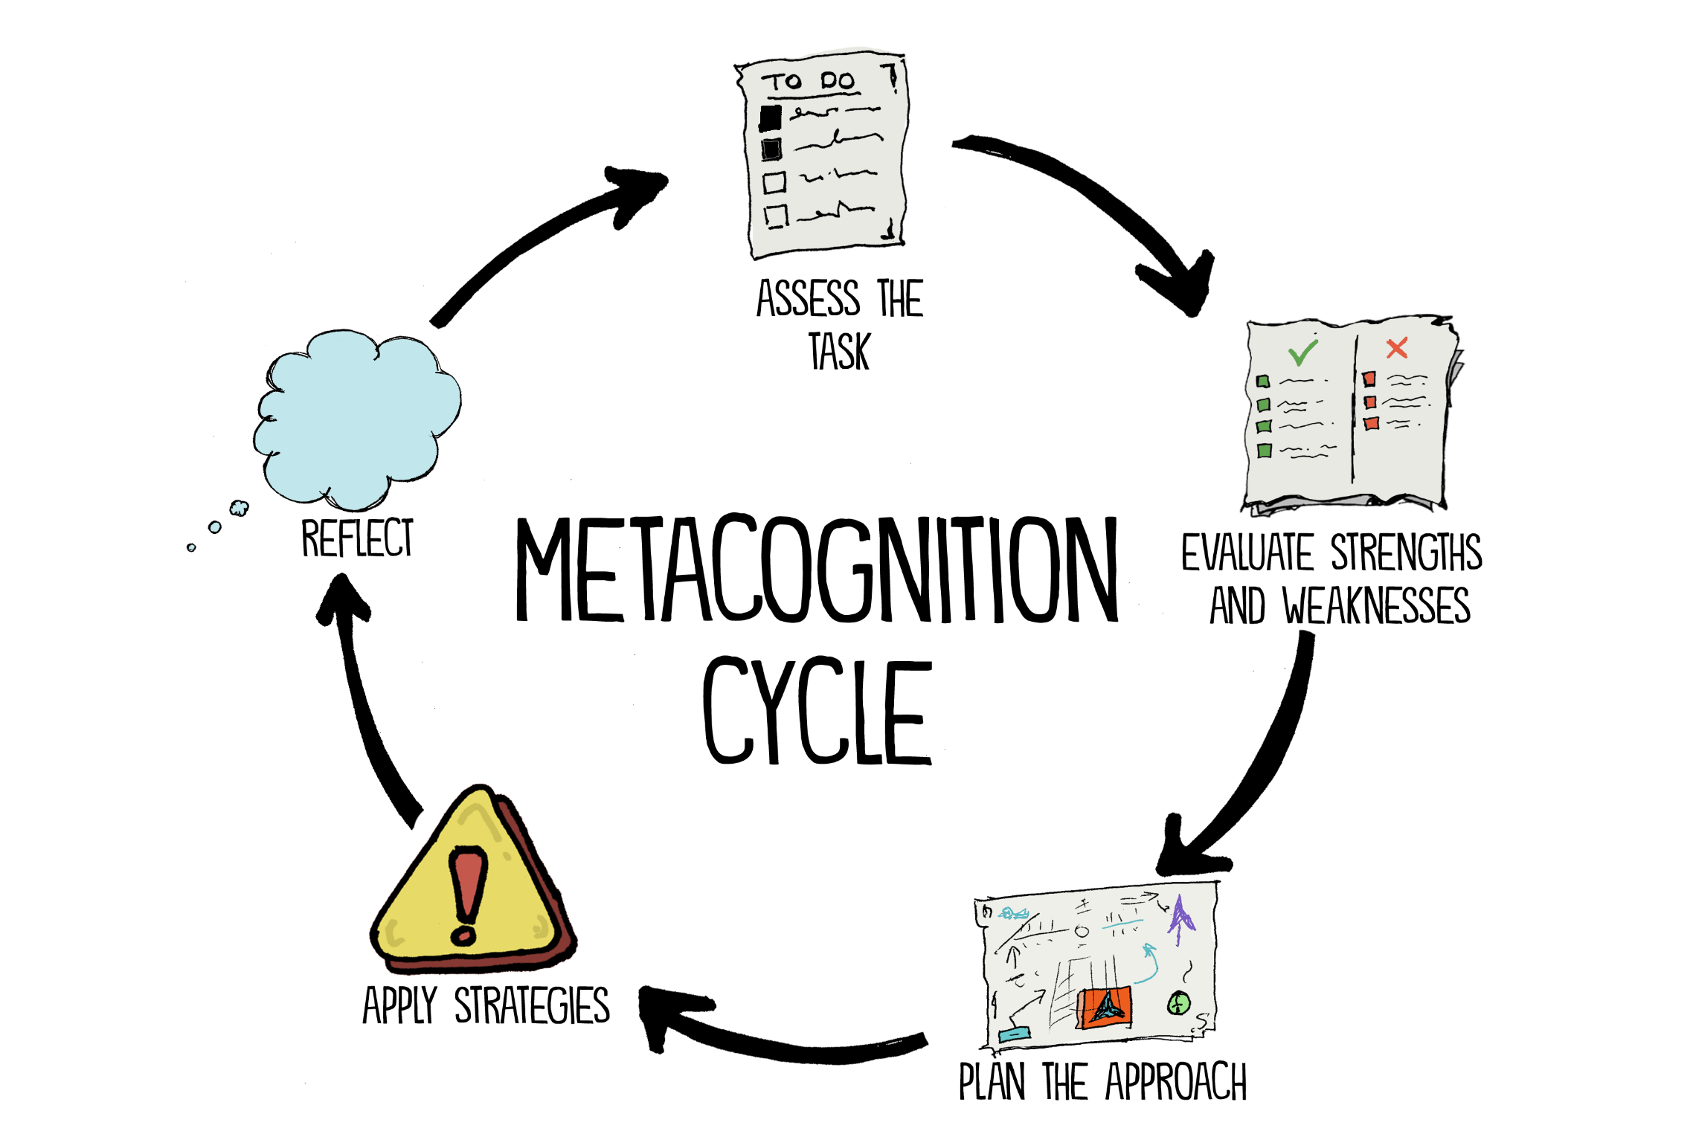

‘Thinking about one’s thinking’

Slide 12

Spaced Practice
A little bit of time every day
Review information from each class, but not immediately
Use active retrieval practice strategies, not just reading notes

Slide 13

Interleaving
Switching between ideas during a study session.
Not studying one idea for too long
Go back over the ideas again in different orders to strengthen understanding

Slide 14

Retrieval Practice
Actively retrieving information from memory without the support of class notes or revision booklets

Slide 15

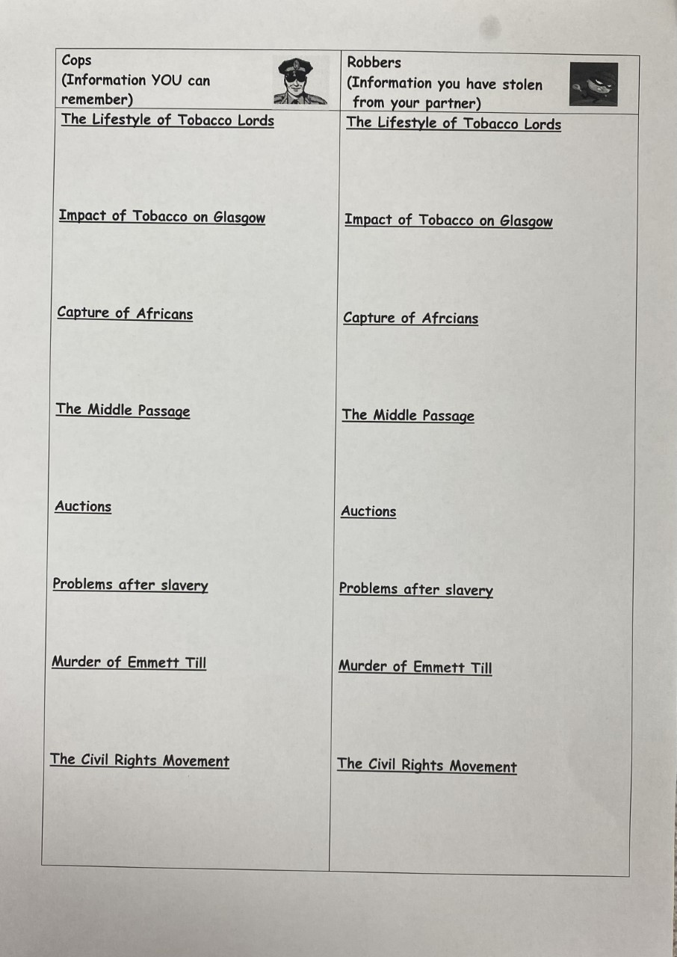

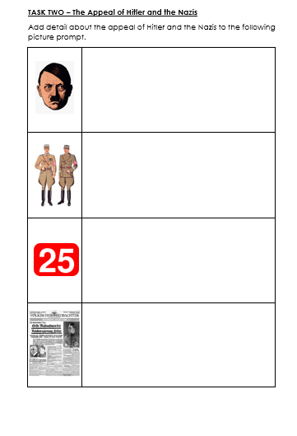
Brain dump
Picture prompt
Cops and robbers

Slide 16
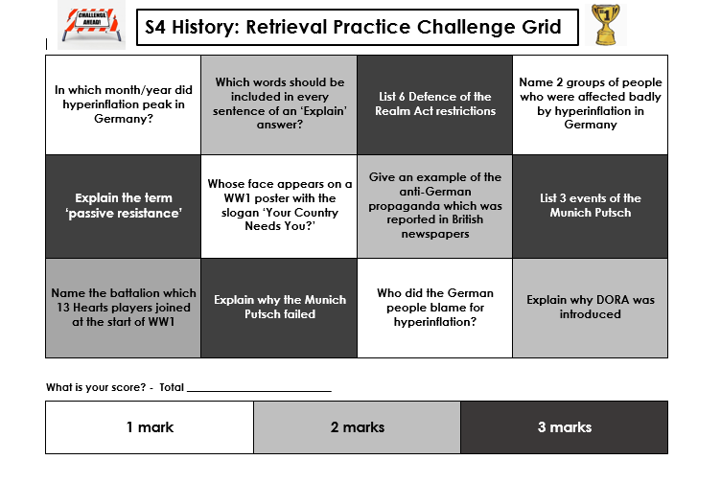
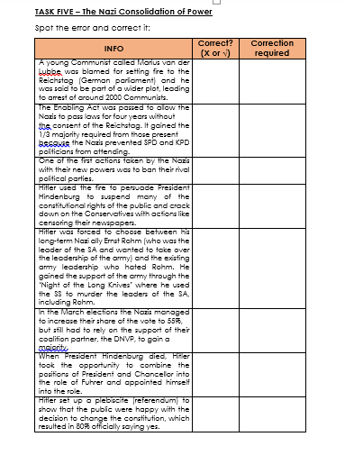
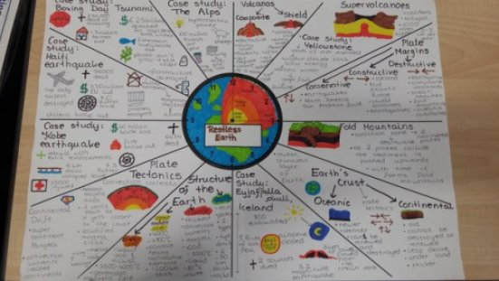
Spot the error
Challenge grid
Revision clocks

Slide 17
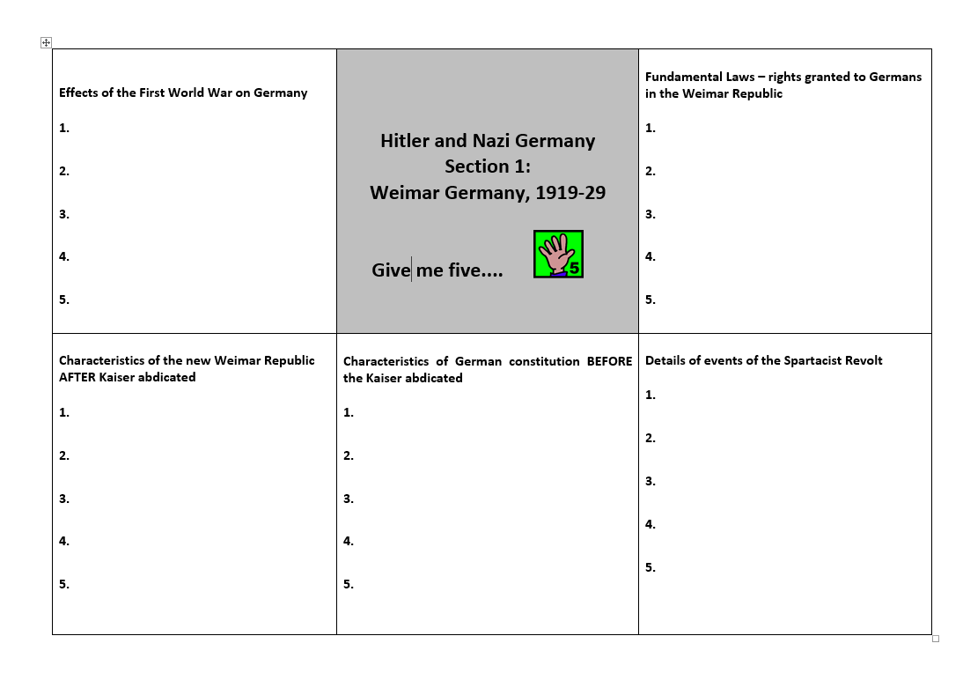
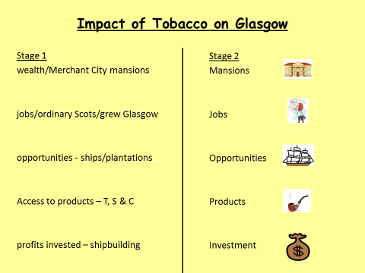
Give me 5
Flashcards

