Slide 1

Higher Business Management
Family Learning 2026

Slide 2


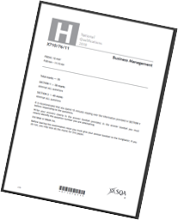
Course Information
Final grade will be made up of two parts:
Question Paper (Final exam)
70 marks (78% final grade)
2 hours and 15 minutes
2. Assignment (Done in class)
30 marks (22% final grade)
8 hours

Slide 3
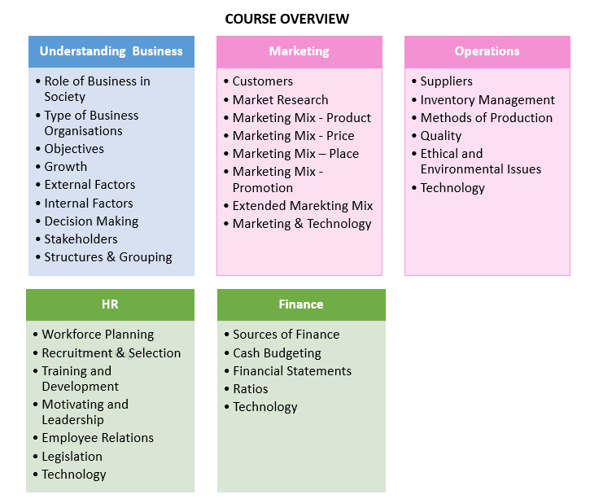
Course Overview

Slide 4
Further Course Information
Qualifications Scotland Website:
https://www.sqa.org.uk/sqa/47919.html
(Includes info on Course Specification, Coursework, Past Papers, etc)
SQA Understanding Standards
https://www.understandingstandards.org.uk/Subjects/BusinessManagement/higher
(Gives info on Candidate Evidence)

Slide 5
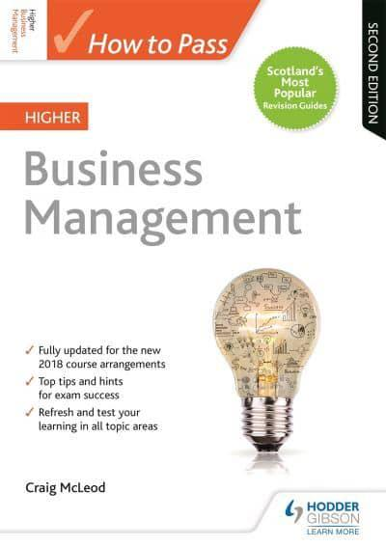
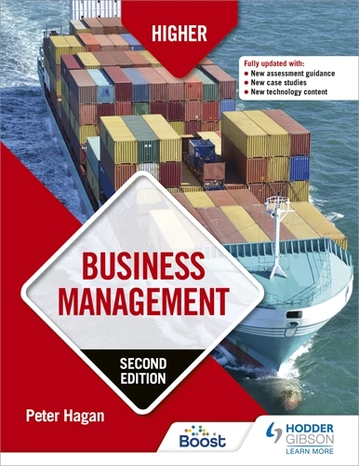
Resources/Support
Lenzie Academy (Notes, Tasks, Homework, Command Words, Revision Packs) - All uploaded to Teams.
Departmental drop in sessions for revision/support - Monday and Wednesday lunchtime.
QS Past Papers
Scholar: https://scholar.hw.ac.uk/
Achieve - https://achieve.hashtag-learning.co.uk/user-start/?next=/
Textbooks:
      Hodder and Gibson - How to Pass
      Hodder and Gibson – Business Management

Slide 6


Exam Top Tips
Attempt Section 2 first. Then read the Case Study from Section 1 to have a rest from writing
Answer every question in the exam – never leave a question blank!
Read the questions related to the case study to know topics to look for. Pupils should read the case study carefully, making notes as they go along. They could even put question numbers beside parts of the case study that are relevant for that question. Make sure they link questions to information in the case study if asked for.
Use proper sentences and use business terminology – avoid one word answers. Bullet points are unlikely to have the detail required. Money is often used wrongly in the exam – Profit/Capital/Revenue etc.
Read the question carefully – once completed, re-read both the question and the answer.
Underline the command word in each question.
Look at the mark allocation – remember at least one sentence per mark.
Keep thinking about timing – make sure to move onto the next section with enough time.

Slide 7
Command Words
Describe
Distinguish
Compare
Discuss
Explain
Justify

Slide 8

Assignment Information
This assignment is worth 30 marks. This is 22% of the overall marks for the course assessment.
Marks for the assignment are as follows:
In this assessment, pupils have to carry out research, analyse information and write a report on an organisation and business issue of their choice. The organisation can operate in the private, public or third sector of the economy.
The business report should be no longer than 2,000 words (excluding appendices, references and footnotes) and should follow the section headings above.
Maximum of four A4-sized pages of appendices; these do not count towards the 2,000 words.
Introduction | 2 marks
Research | 4 marks
Analysis and Interpretation | 13 marks
Conclusions and Recommendations | 10 marks
Structure | 1 mark

