Slide 1

QS Family Learning 2026/27
Higher Maths

Slide 2

Aims of the session
Transition from N5
Overview of the course
Assessment calendar
Resources
Questions

Slide 3
Transition from N5 Maths
National progression statistics:
National 5 Grade (2024) | % achieving A-C in Higher (2025)
A | 89%
B | 43%
C | 26%
Confidence in these N5 topics is vital:
Straight Line
Indices
Simultaneous Equations
Factorising
Quadratics
Breaking brackets

Slide 4
Higher Course Outline
Quadratics
Polynomials
Straight Line
Circle
Trigonometry
Addition Formulae
Differentiation
Vectors
Sets & Functions
Graphs of Functions
Exponential & Logarithmic Functions
Recurrence Relations
Integration
The Wave Function
Covered in June
October Assessment
January Assessment

Slide 5

Assessment Calendar
S5/6 for session 2026/27
October: non-calculator assessment
January: calculator assessment
Ongoing unit assessments as a back-up
QS Exams: Friday 14th May 2027
Paper 1 (55 marks)
Paper 2 (65 marks)

Slide 6

Key Resources
Notes jotter and Teams
Post assessment forms
Zeta electronic textbook (password Lnzac)
Free Higher Maths website (specifically sections 4 & 5)
https://www.highermathematics.co.uk
Achieve Learning website
https://achieve.hashtag-learning.co.uk
Department drop-in sessions

Slide 7
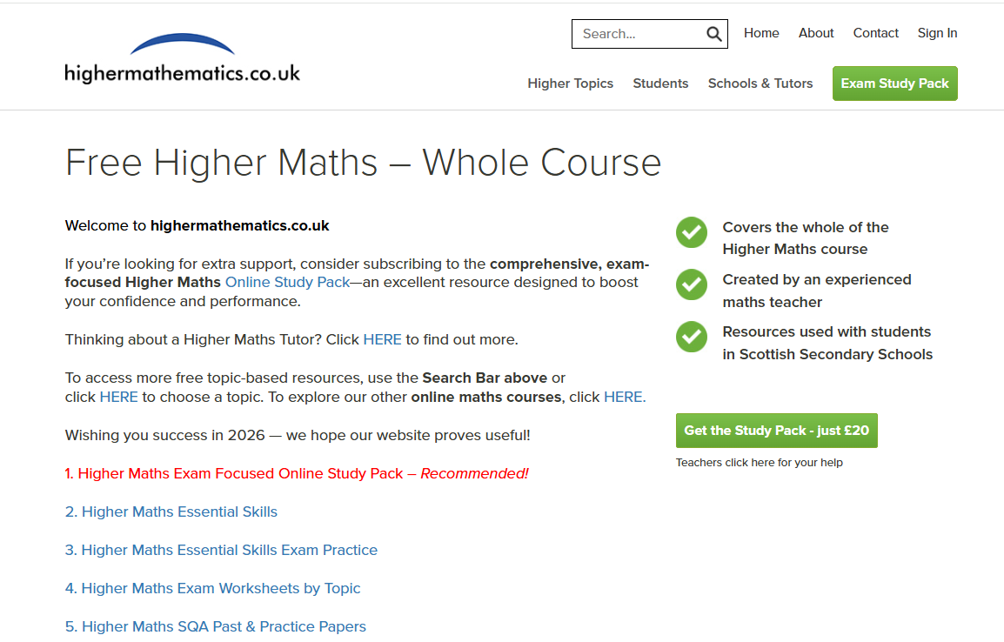

Slide 8
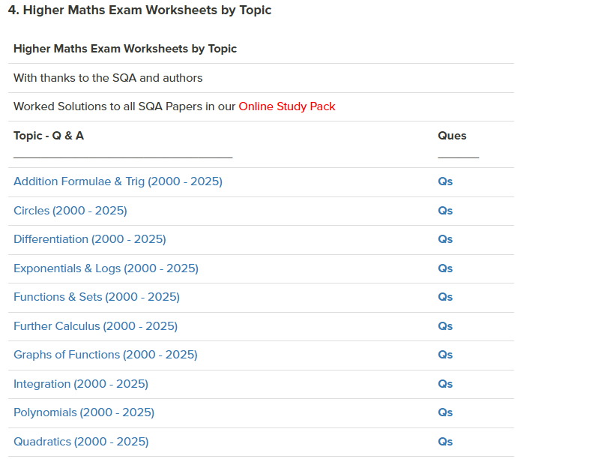
Particularly good for:
targeting areas for development following assessments
revising throughout the year when the course isn’t complete

Slide 9
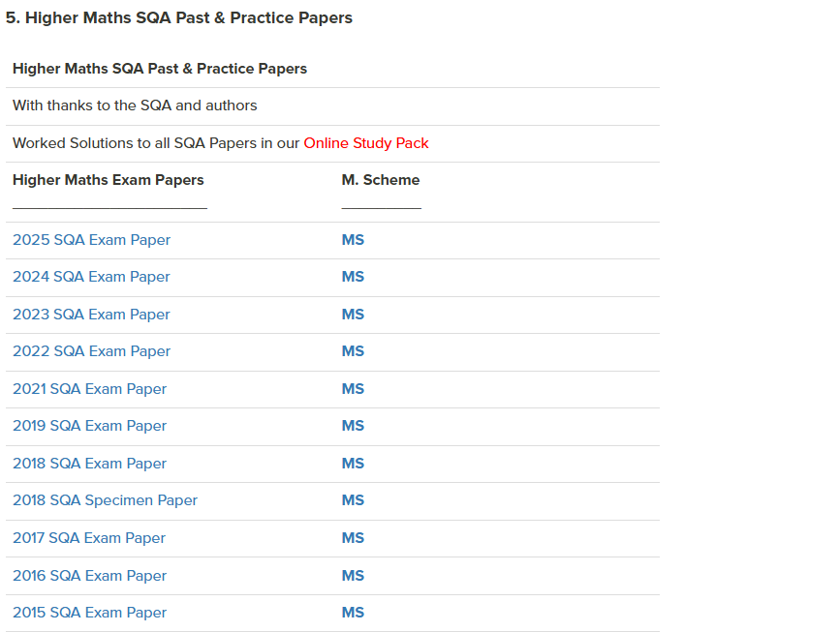
Particularly good for:
end of course assessment preparation
SQA marking schemes & marking notes

Slide 10



How You Can Help
Encourage regular revision at home – little & often!
Check and assess their knowledge with questions.
Help pupils set targets and stick to them.

Slide 11

Questions?

