Slide 1

Advanced Higher Business Management
Family Learning

Slide 2
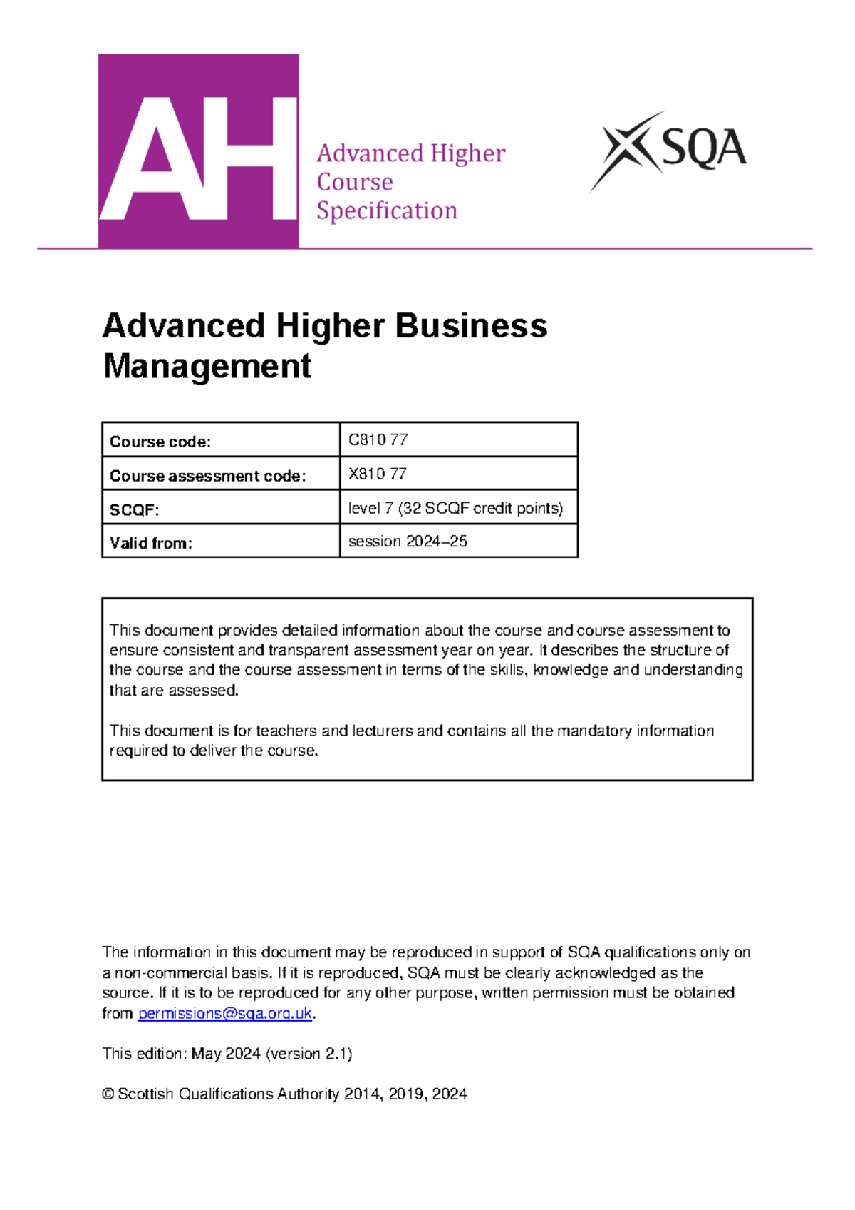
Course Information
Final grade will be made up of two parts:
Component 1: Question Paper (Final Exam) — 80 Marks (67% of total grade | 2 hours 45 minutes)
Section 1 (40 Marks): Mandatory case study based on real-world business.
Section 2 (40 Marks): Four extended response questions sampling across all three units of the course.
Component 2: Project / Dissertation — 40 Marks (33% of total grade | Independent study)
Word Count: 2,500 – 3,000 words (excluding contents, references, and appendices; max 4 A4 pages of appendices).
Focus: Investigation of a strategic business issue facing a real organisation operating in the private, public, or third sector.

Slide 3
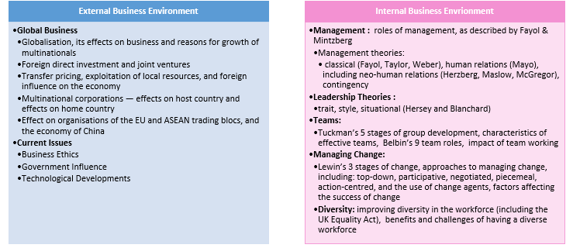
Course Overview

Slide 4
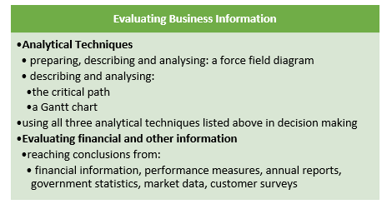
Course Overview

Slide 5

Further Course Information
SQA Website:
Advanced Higher Business Management - Course overview - Qualifications Scotland
(Includes info on Course Specification, Coursework, Past Papers, etc)
SQA Understanding Standards
https://www.understandingstandards.org.uk/Subjects/BusinessManagement/advanced
(Gives info on Candidate Evidence)

Slide 6
Resources/Support
Lenzie Academy (Notes, Tasks, Homework, Command Words, Revision Packs) - All uploaded to Teams.
Departmental drop in sessions for revision/support at lunchtime
SQA Past Papers
Achieve - https://achieve.hashtag-learning.co.uk/user-start/?next=/

Slide 7
Command Words
Describe
Explore
Compare
Discuss
Explain
Analyse
Evalutate

Slide 8


Exam Top Tips
Exam is 2 hours 45 minutes long
Attempt Section 2 first. Then read the Case Study from Section 1 to have a rest from writing
Answer every question in the exam – never leave a question blank!
Read the questions related to the case study to know topics to look for. Pupils should read the case study carefully, making notes as they go along. They could even put question numbers beside parts of the case study that are relevant for that question. Make sure they link questions to information in the case study if asked for.
Use proper sentences and use business terminology – avoid one word answers. Bullet points are unlikely to have the detail required. Money is often used wrongly in the exam – Profit/Capital/Revenue etc.
Read the question carefully – once completed, re-read both the question and the answer.
Underline the command word in each question.
Look at the mark allocation – remember at least one sentence per mark.
Keep thinking about timing – make sure to move onto the next section with enough time.

Slide 9

Project Information
The Project is worth 40 marks. This is 33% of the overall marks for the course assessment.
Marks for the assignment are as follows:
In this assessment, pupils have to carry out research, analyse information and write a report on an organisation and business issue of their choice. The organisation can operate in the private, public or third sector of the economy.
The business report should be no longer than 3,500 words (excluding appendices, references and footnotes) and should follow the section headings above.
Introduction | 5 marks
Analysis and Interpretation | 20 marks
Conclusions and Recommendations | 8 marks
Research | 3 marks
Structure & Referencing | 4 marks

