Slide 1
WELCOME

Slide 2
Supporting Your Child Through the QS Process
National 5 Modern Studies

Slide 3
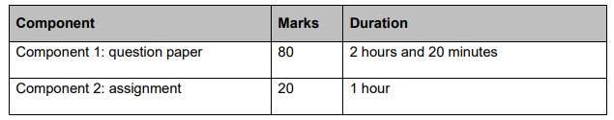
Course Assessment
has two components:

Slide 4
QS Exam Structure
KNOWLEDGE & UNDERSTANDING QUESTIONS
SKILLS QUESTIONS
Democracy in the UK OR Democracy in Scotland
Social Issues – Crime and the Law
World Powers – the USA
Support/Oppose
Option choice (decision making)
Conclusions

Slide 5
QS Exam Structure
Pupils must answer a range of 4 and 6 mark knowledge ‘describe’ questions, 6 mark ‘explain’ questions and one 8 mark ‘explain’ question in the exam paper.
The 8-mark ‘explain’ question can be asked in any of the three sections.
There is a choice of two questions, pupils answer one of them.
There are three knowledge questions in each section (describe/explain).
There are three skills questions asked across the paper (support/oppose, option choice, conclusions).
There is only one skills question per section.

Slide 6
Skills Questions
Support/Oppose – pupils must correctly identify pieces of evidence to support a statement and pieces of evidence to oppose a statement from three sources of information given.
Option choice (decision making) – pupils must make an informed decision (from two options given) and provide evidence from three sources of information given to justify the decision they’ve made.
Conclusions - pupils must draw conclusions on a number of issues based on evidence from three sources of information given.
These questions are worth 10 marks each.

Slide 7
Assignment
Pupils have a choice of a Modern Studies relevant topic or issue.
Their choice should refer to a contemporary political, social or international issue.
The write up for this is in mid-December.
It was completed under exam conditions and marked by QS.
It is worth 20% of the overall marks available for N5.

Slide 8
Revision Resources - Knowledge
Pupils must learn detailed exemplification to support the points they make in their knowledge responses – these are taught in class.
Pupils are issued with a revision booklet of course notes prior to the final exam.
They are also given a booklet of past paper questions, which they use for practice.

Slide 9
Revision Resources - Skills
Pupils have a designated skills period each week.
Pupils are issued with a past paper booklet of skills questions, which includes writing frames.
During the skills period, pupils undertake timed practice, answering the three different types of skills question.
A different skill is practised each week.
These are marked and returned to pupils the following week.

Slide 10
QS Exam Information
QS Course Specification and Past Papers/Marking Instructions - https://www.sqa.org.uk/sqa/47448.html

Slide 11

QS Website
Course Structure
Type of Question
PEE Structure
Skills Writing Frames
Key
Terminology
Timed
Practice

Slide 12


Slide 13

Thank you for being here this evening

