Slide 1

QS Family Learning 2026/27
National 5 Maths

Slide 2

Aims of the session
Overview of the course
Assessment calendar
Resources
Questions

Slide 3
Nat 5 Maths Course Outline
Topics Covered in S3
S4 Course
Brackets
Equations
Arcs and Sectors
Statistics
Simultaneous Equations
Pythagoras
Factorising
Volume
Percentages
Scientific Notation
Angles and Circles
Fractions
Straight Line
Similarity
Algebraic Fractions
Changing the subject
N5 Numeracy Assessment
Surds
Indices
Vectors
Equations & Inequations
September Assessment (non-calculator) - w/b 28th September
Further Trigonometry
Trigonometric Graphs
Quadratics
January Assessment (calculator)
Functional Notation
Trigonometric Identities
Trigonometric Equations

Slide 4

QS Exam 2027
Monday 17th May 2027
9.00 – 10.00: Paper 1 non-calculator (40 marks)
10.30 – 12.00: Paper 2 calculator (50 marks)
All results for N5 Maths are 100% exam based.

Slide 5

Key Resources
Notes jotter and Teams – regular revision of key topics.
Post assessment forms – strengths & areas for development.
Zeta electronic textbook (password Lnzac).
Free N5 Maths website (specifically sections 2-5).
https://www.national5maths.co.uk/free-national-5-maths/
Achieve Learning website.
https://achieve.hashtag-learning.co.uk
Department drop-in sessions.

Slide 6
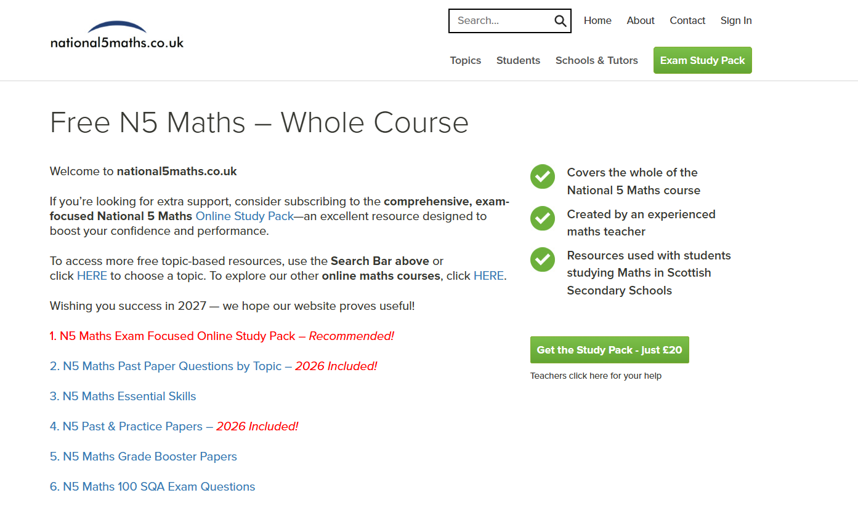

Slide 7
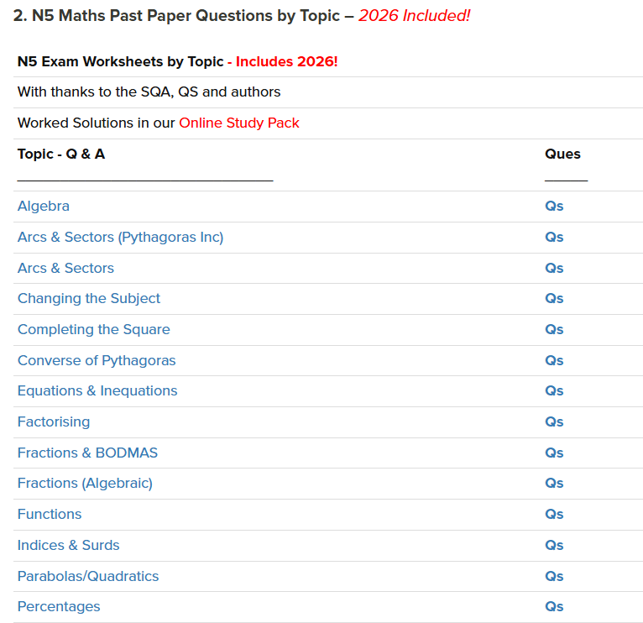
Particularly good for:
targeting areas for development following assessments
revising throughout the year when the course isn’t complete

Slide 8
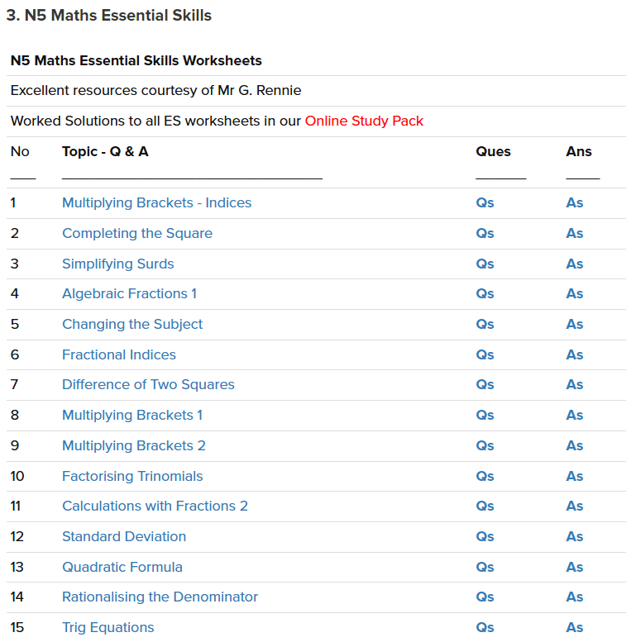
Particularly good for:
repetition of specific skills
building confidence before tackling past papers

Slide 9
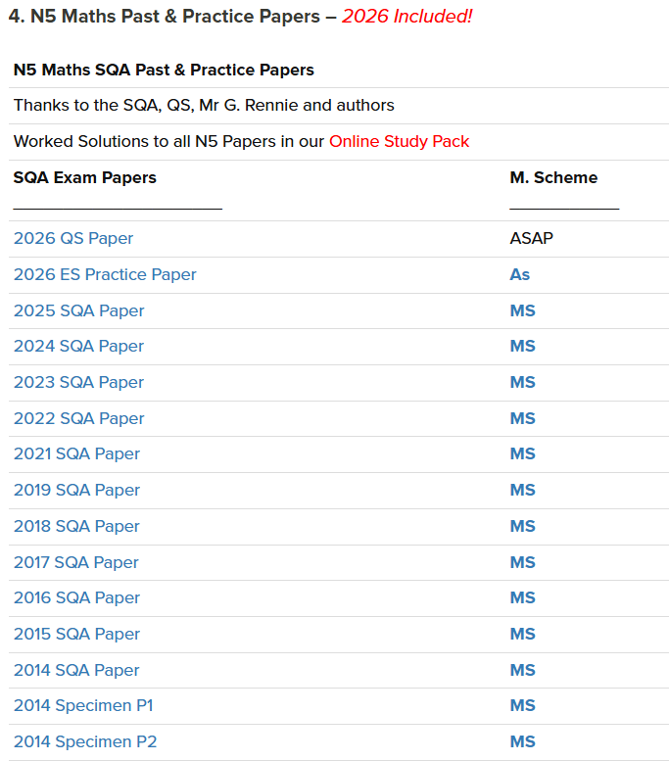
Particularly good for:
end of course assessment preparation
SQA marking schemes & marking notes
*Pre 2014, the SQA equivalent was Standard Grade Credit Maths. These papers are also good practice.

Slide 10
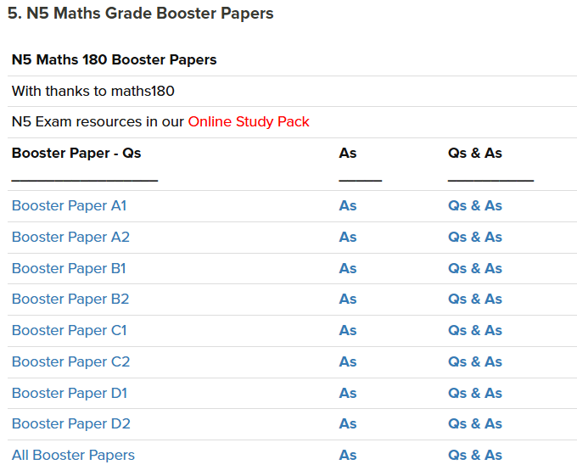
Particularly good for:
further practice of exam timing & technique
building confidence before the exam (Booster papers increase in difficulty from A-D)

Slide 11



How You Can Help
Encourage regular revision at home – little & often!
Check and assess their knowledge with questions.
Help pupils set targets and stick to them. Make use of our post assessment forms.

Slide 12

Questions?

