Slide 1


QS Family Learning Event
Higher
Chemistry
Mr McDowell
Principal Teacher of Chemistry

Slide 2
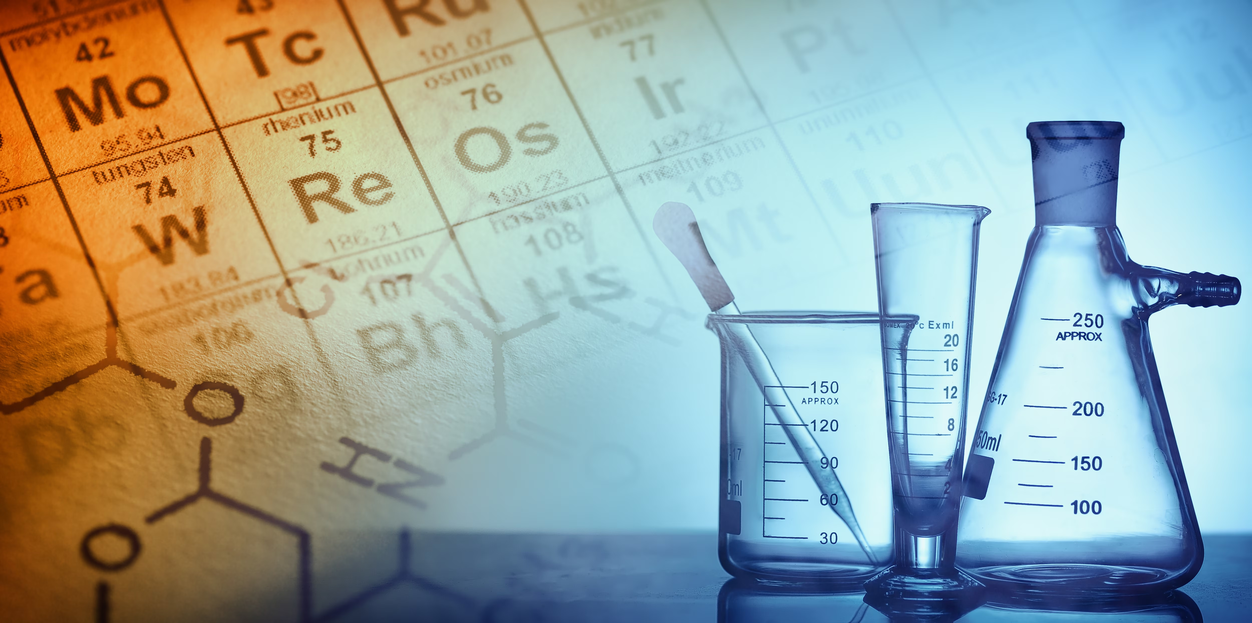

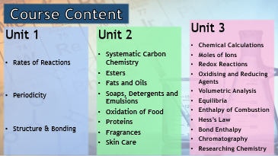
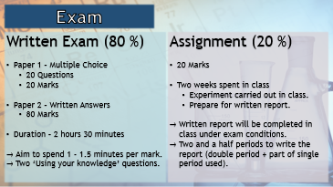



Information
Course Content
Exam
Revision

Slide 3
Course Content
Unit 3
Chemical Calculations
Moles of Ions
Redox Reactions
Oxidising and Reducing Agents
Volumetric Analysis
Equilibria
Enthalpy of Combustion
Hess’s Law
Bond Enthalpy
Chromatography
Researching Chemistry
Unit 1
Rates of Reactions
Periodicity
Structure & Bonding
Unit 2
Systematic Carbon Chemistry
Esters
Fats and Oils
Soaps, Detergents and Emulsions
Oxidation of Food
Proteins
Fragrances
Skin Care

Slide 4
Exam
Written Exam (80 %)
Section 1 – Multiple Choice
  20 Questions
  20 Marks
Section2 – Written Answers
  80 Marks
Duration – 2 hours 30 minutes
Aim to spend 1 - 1.5 minutes per mark.
Two ‘Using your knowledge’ questions.
Assignment (20 %)
20 Marks
Two weeks spent in class
  Experiment carried out in class.
  Prepare for written report.
Written report will be completed in class under exam conditions.
Two and a half periods to write the report (double period + part of single period used).

Slide 5

Revision

Slide 6
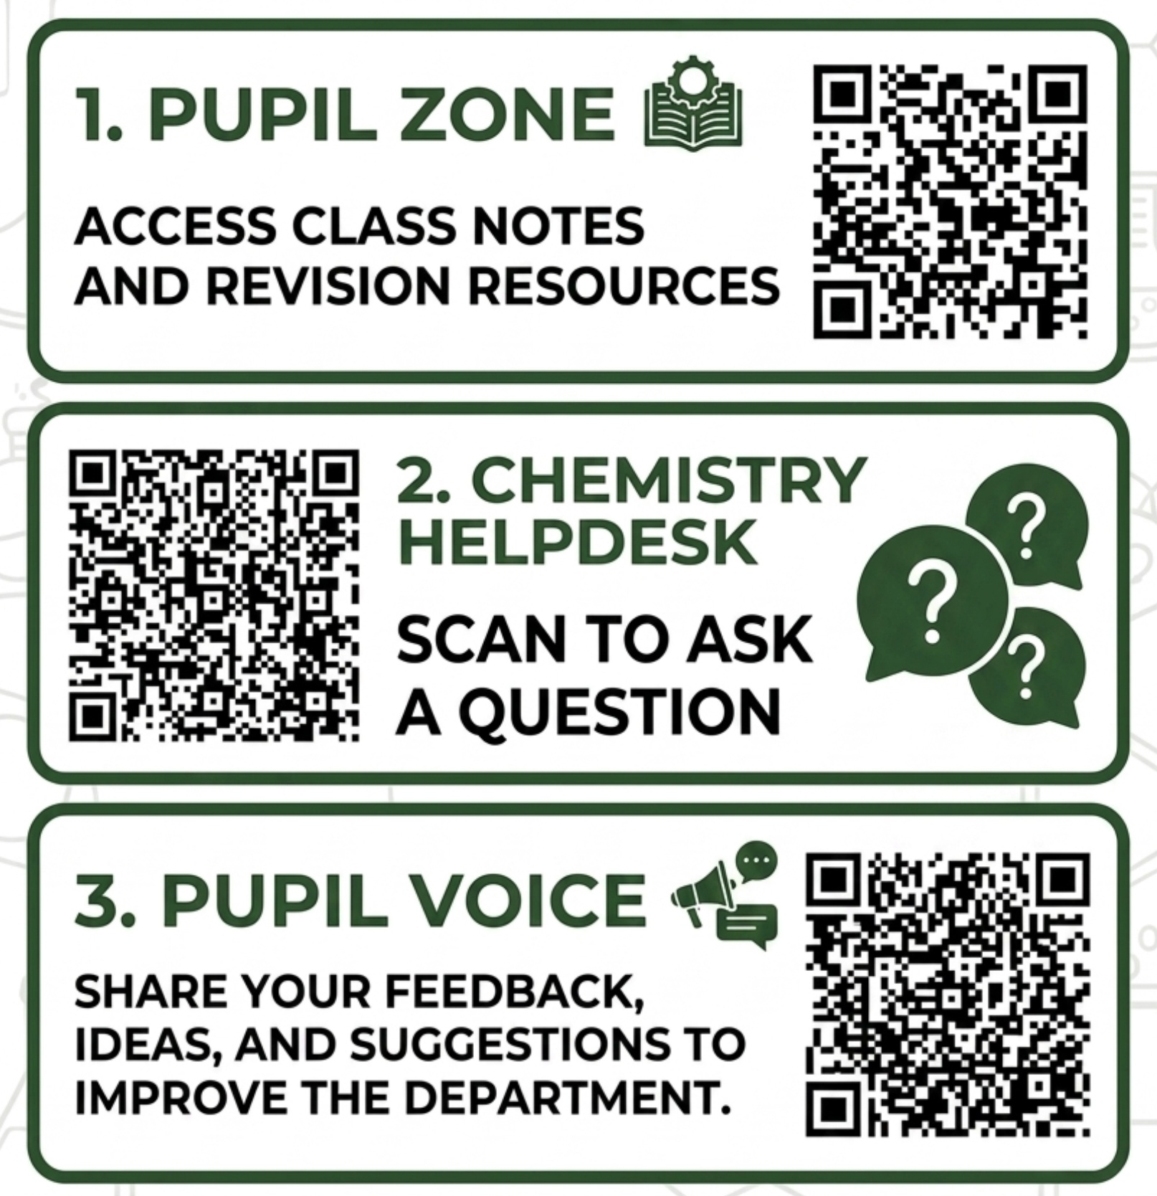

Slide 7


