Slide 1

WELCOME
THANK YOU FOR ATTENDING THIS EVENING

Slide 2
Business Management
National 5

Slide 3

Course Information
Course assessment is made up of two parts:
Question Paper (Final Exam)
  70 marks completed in 1 hour and 30 mins (Change for this year)
Assignment (Completed in Class)
  30 marks completed in 5 hours of class time

Slide 4
Course Overview
Understanding Business
Marketing
Role of Business in Society
Customer Satisfaction
Types of Business organisations
Objectives
External Factors
Internal Factors
Stakeholders
Customers
Market Research
Marketing Mix
Product
Price
Place
Promotion
Technology
Operations
Human Resources
Finance
Suppliers (Purchasing Mix)
Inventory Management
Methods of Production
Quality
Ethical and Environmental
Technology
Recruitment and Selection
Training
Motivation and Retention
Legislation
Technology
Sources of Finance
Break-even
Cash Budgeting
Income Statements
Technology

Slide 5
Further Course Information
SQA Website:
National 5 Business Management - Course overview and resources – SQA (Includes info on Course Specification, Coursework, Past Papers, etc.)
SQA Understanding Standards:
SQA - Understanding Standards: National 5 (Gives info on Candidate Evidence)

Slide 6
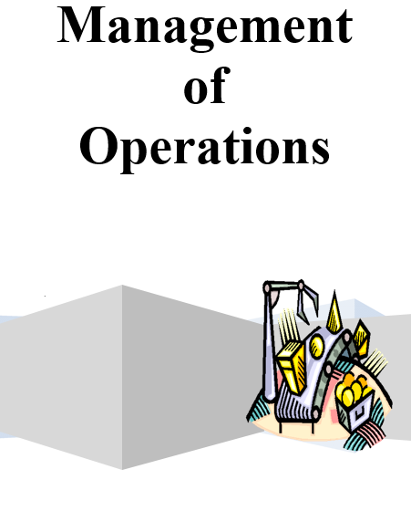
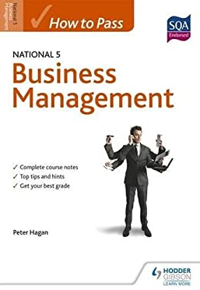
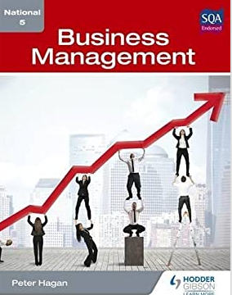
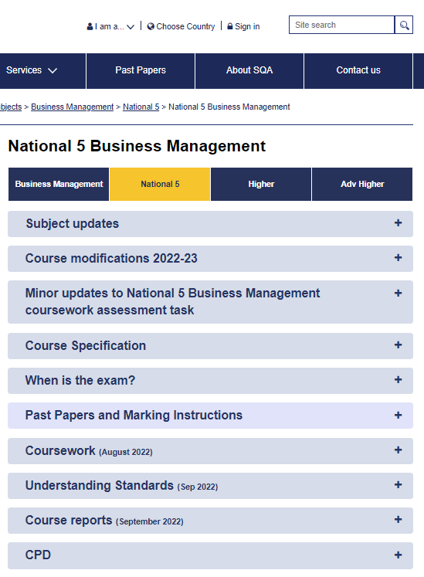
Resources
Lenzie Academy (Course Notes, Tasks, Homework, Command Word Cheat Sheets & Revision Packs) – available on Teams
Qualifications Scotland Past Papers
Achieve: all pupils should be signed up now
Textbooks:
      Hodder and Gibson - How to Pass
      Hodder and Gibson – Business Management

Slide 7
Command Words
Identify / State
Outline / Suggest
Describe
Compare
Discuss
Distinguish
Justify
Explain

Slide 8


Question Paper Top Tips
Exam is 1 hour and 30 minutes long
Pupils may choose to start with Section 2 first – it is their choice. They should trial this approach in practice papers!
Answer every question in the exam – never leave a question blank!
Read the questions related to the case study to know topics to look for. Read the case study carefully, making notes if you like. Make sure they link questions to information in the case study if asked for.
Use proper sentences and use business terminology – avoid one word answers.
  Money is often used wrongly in the exam – Profit/Capital/Revenue etc.
Read the question carefully – once completed, re-read both the question and the answer.
Command words are critical and underline key elements in each question.
Look at the mark allocation – remember at least one sentence per mark.
Keep thinking about timing – make sure to move onto the next section with enough time.

Slide 9
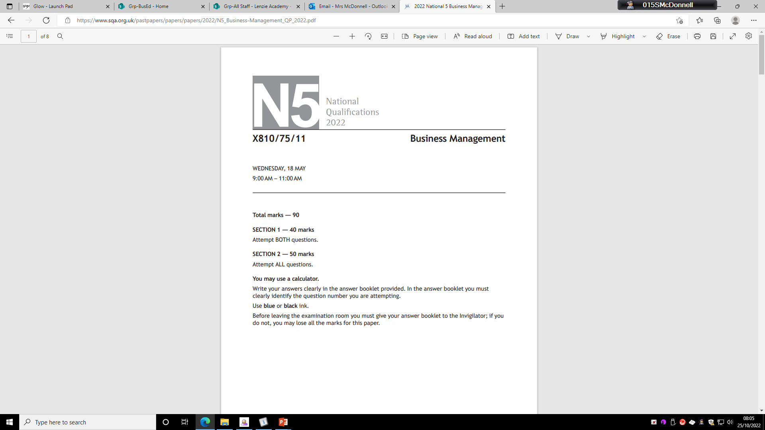
Question Paper Break Down
SECTION 1
SECTION 2
1 x 20 mark question based on stimulus material – based on real organisations and can be text, financial information, graphs, charts etc
Sub-questions range in value between 1 and 5 marks
In general questions assess decision-making, and the application of knowledge and understanding, and can sample course content from any of the five areas of study
5 x 10 mark questions
Sub-questions range in value between 1 and 4 marks
In general questions assess the application of knowledge and understanding, and each samples from one of the five different areas of study

Slide 10
Assignment – 30 Marks
Headings | Mark Allocation
Background Information | 4 Marks
Research Methods and Sources | 6 Marks
Findings, Analysis and Interpretation | 12 Marks
Conclusion(s)/ Recommendation(s) | 6 Marks
Collating and Reporting | 2 Marks
The Assignment requires candidates to choose a business and conduct in depth research, analyse and interpret their findings and provide detailed recommendations / conclusions based on their findings in a report format.
The final report should be a maximum of 1,300 words (excluding appendices). If the wordcount exceeds the limit, they can be penalised. Appropriate headings should be used throughout the report. Appendices should be a maximum of two pages.

Slide 11
Any questions?
Thank you for listening

