Slide 1
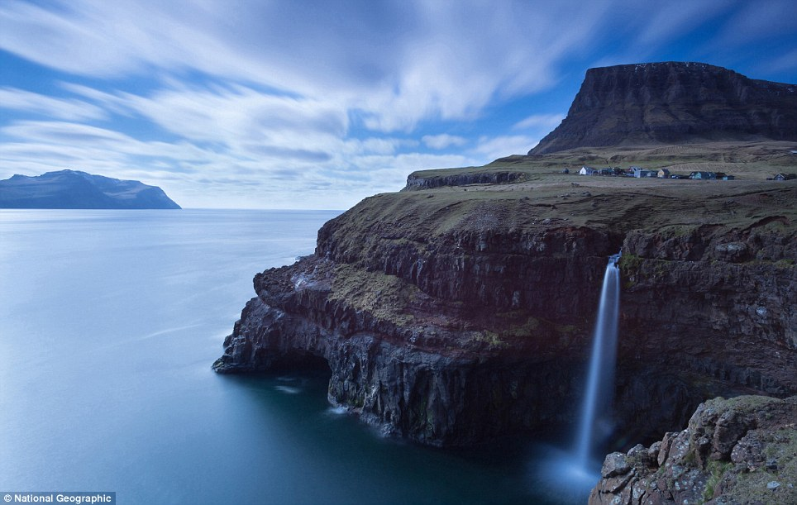


Geography Study Skills
Qualification Scotland
National 5 / Higher

Slide 2
Objectives
1 – Course outline
2 – Revision resources
3 – Retrieval practice exercise

Slide 3
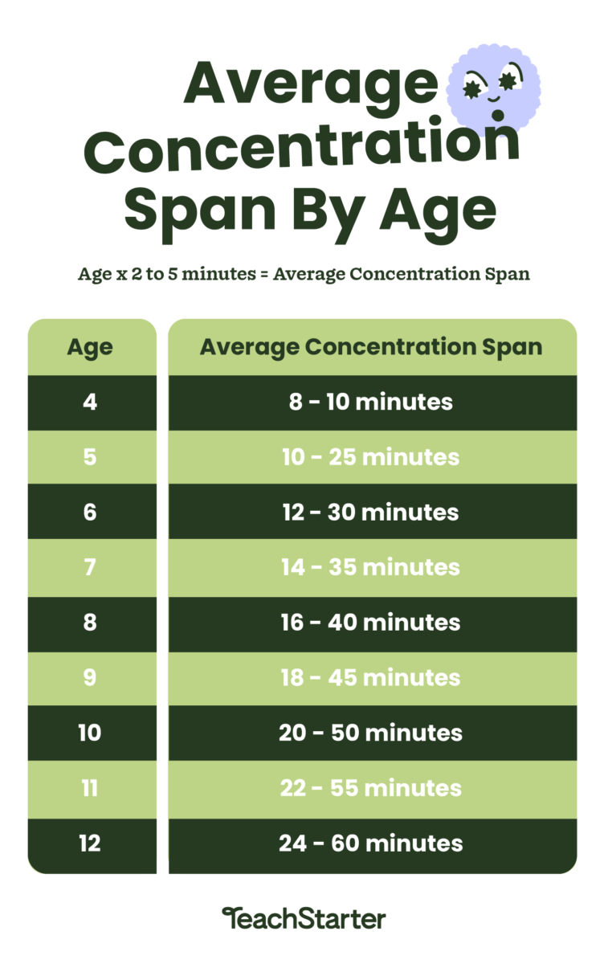

How to study Geography…

Slide 4
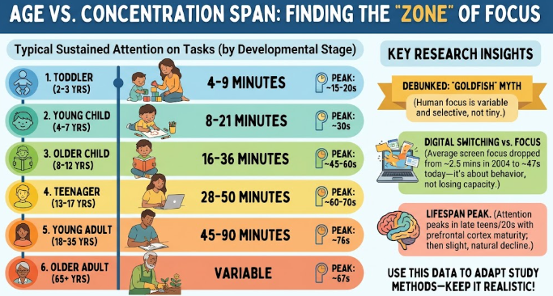
Levels of Concentration

Slide 5
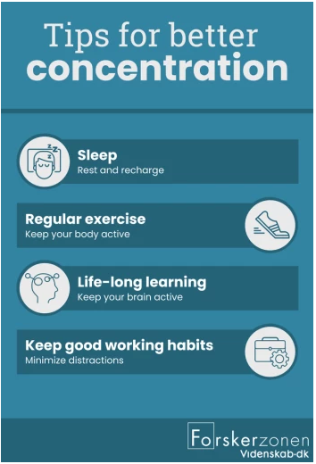

Slide 6





Study Skills…
10% of what we read
20% of what we hear
30% of what we see
50% of what we see and hear
80% of what we experience
95% of what we teach someone else
When do we learn?

Slide 7
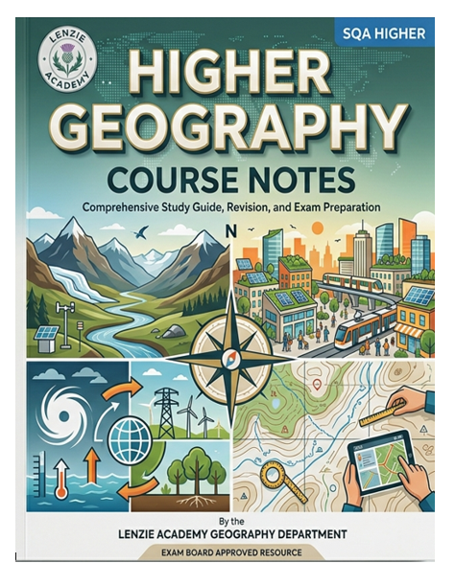



Department Hard Copy Resources
What can you use to study Geography?
Class notes (Jotters)
Course Notes
Past Paper Question Booklet

Slide 8
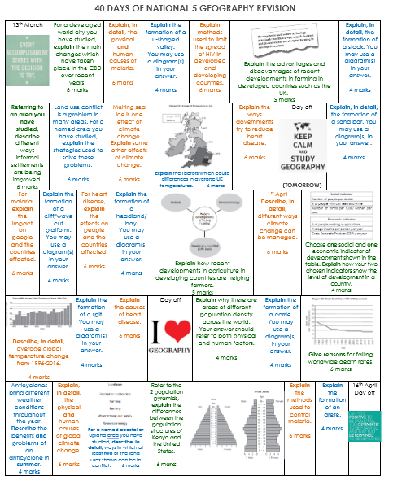
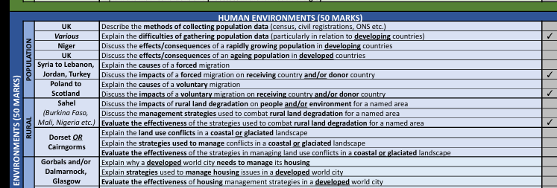
40 Days of Geography + History of Questions

Slide 9





Digital Resources for Pupils

Slide 10

Draw the Olympic Game symbol with the right colours in the right position?
Notes:
Easier to remember when we understand the why? The Olympic rings are the colours that they are because every countries flag has at least one of these colours.& interlinked to represent unity.

Slide 11
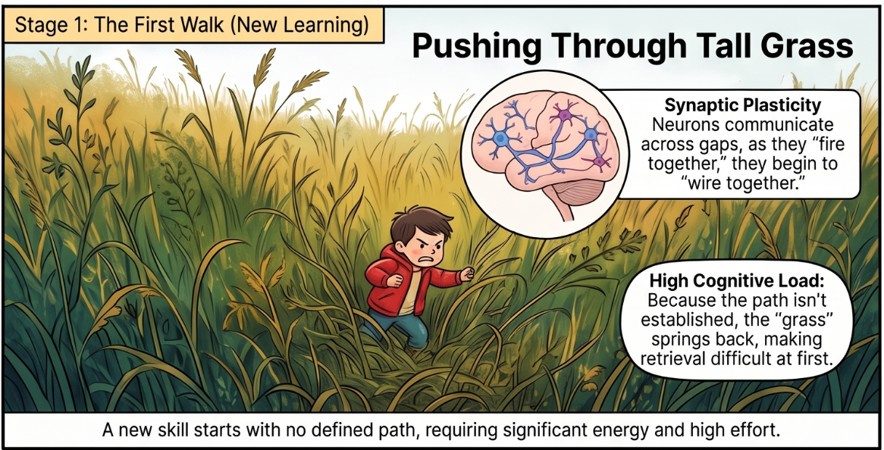
Creating Brain Pathways

Slide 12
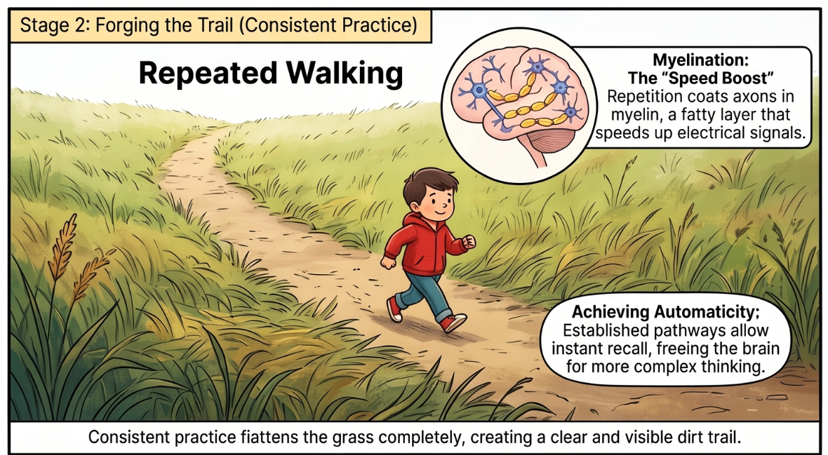

Slide 13
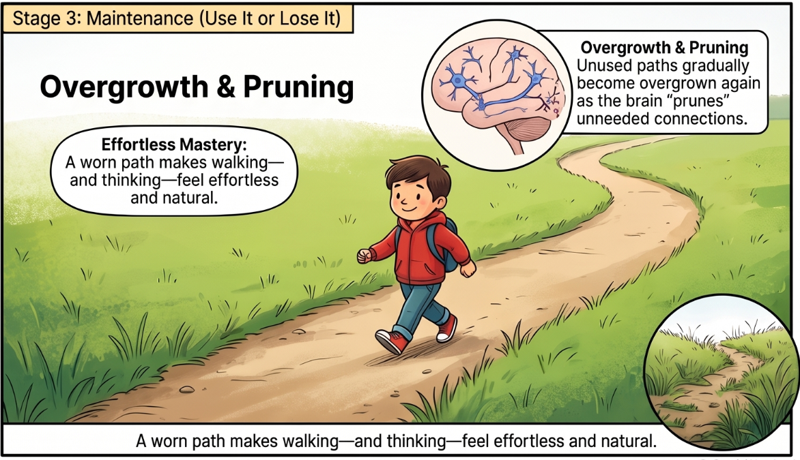

Slide 14
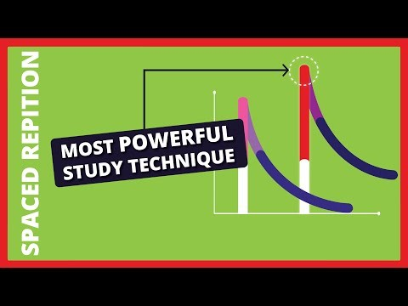

Slide 15
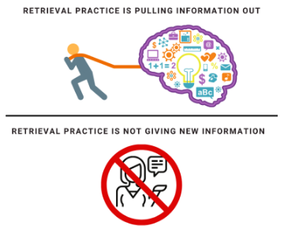
Retrieval Practice
Step 2 – Check your answer and make changes
*Change pen colour to highlight the gaps in your knowledge

Slide 16
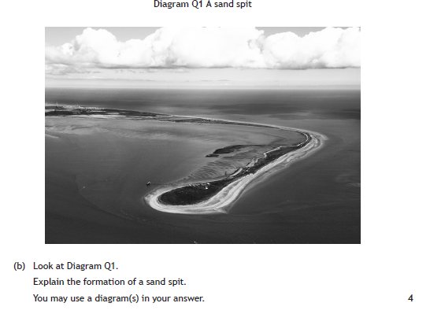

Effective Retrieval Practice
Notes:
Do the Q first no notes – then go back with coloured pencil and add in the bits you have missed then you know to study these first

Slide 17
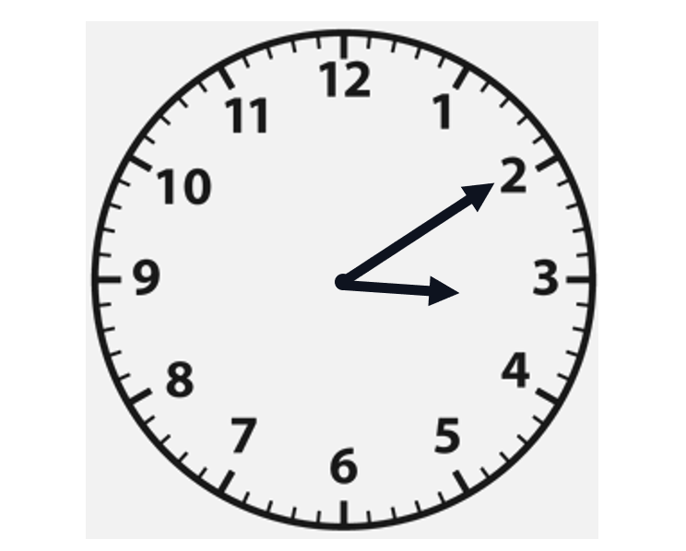
Biggest Geography Challenge - TIMING
While most pupils are able to recall the information, the biggest challenge is the time in which to do it.
N5 – 1min 30 sec per mark
H – 1 min 10 sec per mark

Slide 18

Retrieval Practice
Here’s something everyone should know…
Name all the chocolates in the Celebration box.
Twix
Snickers
Mars
Malteaser
Galaxy caramel
Galaxy
Bounty
Milky way

